Slide 1


SUPPORTING SMOOTH TRANSITIONS
For You And Your Child
WELCOME TO
Oakwood Primary School
1st July 6pm – 7pm
Mrs Thompson (Headteacher), Mr Stanway (Deputy Headteacher), Miss Stubbs (SENCo), Miss Denson (EYFS Lead, Acorns 2 class teacher), Ms Bowden (Acorns 1 class teacher)
Notes:
Insert the school logo, date, time and name of presenter
Encourage parents to look around the classroom/provision for the first 10 minutes.
Room Set up – Think about the best way to arrange the seating, keeping in mind that you will want all parents to see the presentation and to be able to talk in small groups. You may want to play music and offer refreshments as parents arrive.
Give out induction packs as parents enter and keep a register so that you know who has attended.
Make sure the evaluation sheets/post-its and pens/pencils are on the chairs/tables for parents to access during the induction.
Welcome the parents/carers and introduce yourself

Slide 2

WELCOME TO A NEW AND EXCITING STAGE IN YOUR CHILD’S LIFE!
During their Reception year your child will:
make new friends
enjoy new experiences
learn how the school day runs
learn vital new skills including reading and writing
We, teachers and parents, have the chance to work as
partners to ensure that at the end of this school year,
your child will have a positive attitude towards their
education based on social and academic confidence.

Slide 3

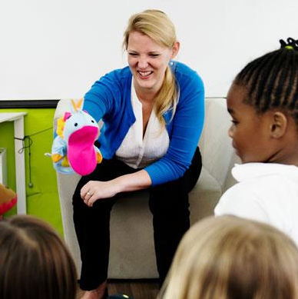
AIMS OF THE THIS MEETING
To provide ideas so we can effectively work together
and how you can best support your child at home.
To find out more about what your child
will be doing in school.
To explain our school procedures.
Notes:
Insert own school photos
The curriculum for every child under the age of 5
Parents as partners
What this school does specifically – policies, expectations etc

Slide 4

ACORNS (RECEPTION)
At Oakwood, our KS1 and KS2 classes are named after trees.
In Reception, we are Acorns.
We have 2 reception classes (Acorns 1 and Acorns 2)
There are up to 45 children in total
Sometimes we work within our class and other times we learn together
We use both the indoor and outdoor spaces all year round to explore and create new learning opportunities.
We also take part in our school’s OPAL play curriculum at lunchtimes, which is an opportunity for your child to play with children across the school.

Slide 5



WHY IS TRANSITION SO IMPORTANT FOR YOUR CHILD?
Transition: A process not an event
Each child is different and some may take a little longer to settle
Our transition processes are based on the best interests and needs of your child
We will work with you to help your child to settle and be confident in their new surroundings
Notes:
School insert own pictures
‘Transition: A process not an event’ reference that this statement appears in several documents/research etc – for example ICAN, Alistair Bryce Clegg, etc
Talk about each bullet point on the slide, reassuring parents that most will children settle well and that support is available for those who take a little longer. Explain that you will work in partnership because you recognise that parents are experts in knowing their child’s needs and staff are very experienced in supporting new children to settle.
Research suggests that children will find it easier to settle into school if they…
have strong social skills
can cope emotionally with being separated from their parents
are relatively independent in their own personal care
have a curiosity about the world and a desire to learn

Slide 6
GETTING TO KNOW YOU AND YOUR CHILD
We will do this by:
Family Meetings (September 3rd and 4th)
Stay and play session (July 9th 10am-11:30am)
Nursery Visits
Information gathered from you and the previous setting
Transition for each child carefully planned with you and the class teacher
Opportunities to ask questions and share concerns
Notes:
Edit this slide to reflect your own support for transition.
Talk about all the different ways you get to know the child and their family and the opportunities to share and exchange information about their child.
Explain how the key person relationship supports children to settle well.
Emphasise that staff are available to talk to parents who have concerns about their child.

Slide 7
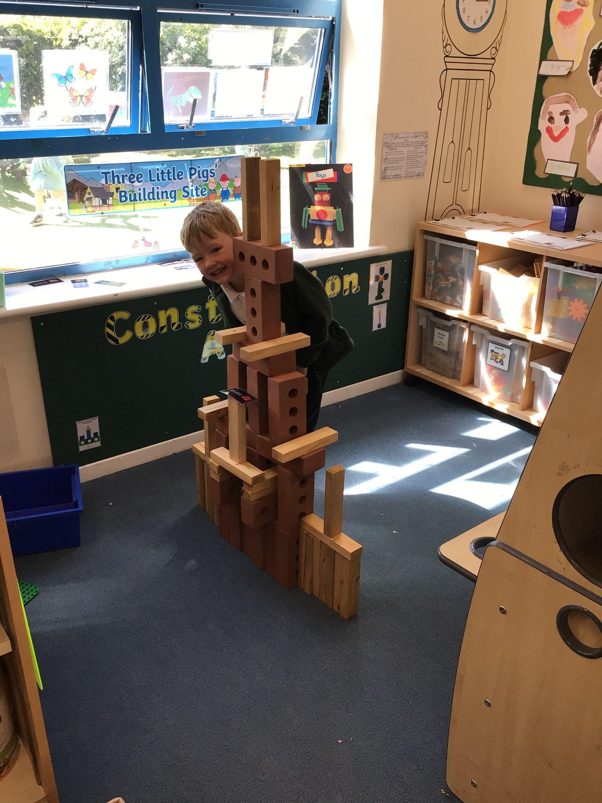

HOW WILL MY CHILD LEARN?
Your child will have PLENTY of time to play everyday.
This will be planned, purposeful play and through a mix of adult led tasks and child-initiated activity.
We call this Active Learning at Oakwood.
Your child will be assessed in these areas, based on their individual development and needs. We will share some ‘wow’ moments with you in your child’s online Learning Journal (Evidence Me)..
Notes:
Optional (or you may want to use this at a second session)
If preferred insert photos of the ways in which children learn in your school/provision.
Optional to do the following dependent on the needs of your community and parents/carers
Activity – Parents look at each of the photos and consider what is being learnt/developed. Encourage parents to discuss what they can see and what children might be learning in these situations. Parents/carers to be given a copy of the photos on the slide so that they can make notes and take it away to share with other family members.
In the discussion following the activity give a short explanation of why the activity in each photo is beneficial e.g. hanging from bars to build upper body strength (writing), listening to adults read a book (story time), board games (mathematics), sand/water play (problem solving), clearly labelled drawers/shelves (independence), role-play/collaborative play (make friends).

Slide 8
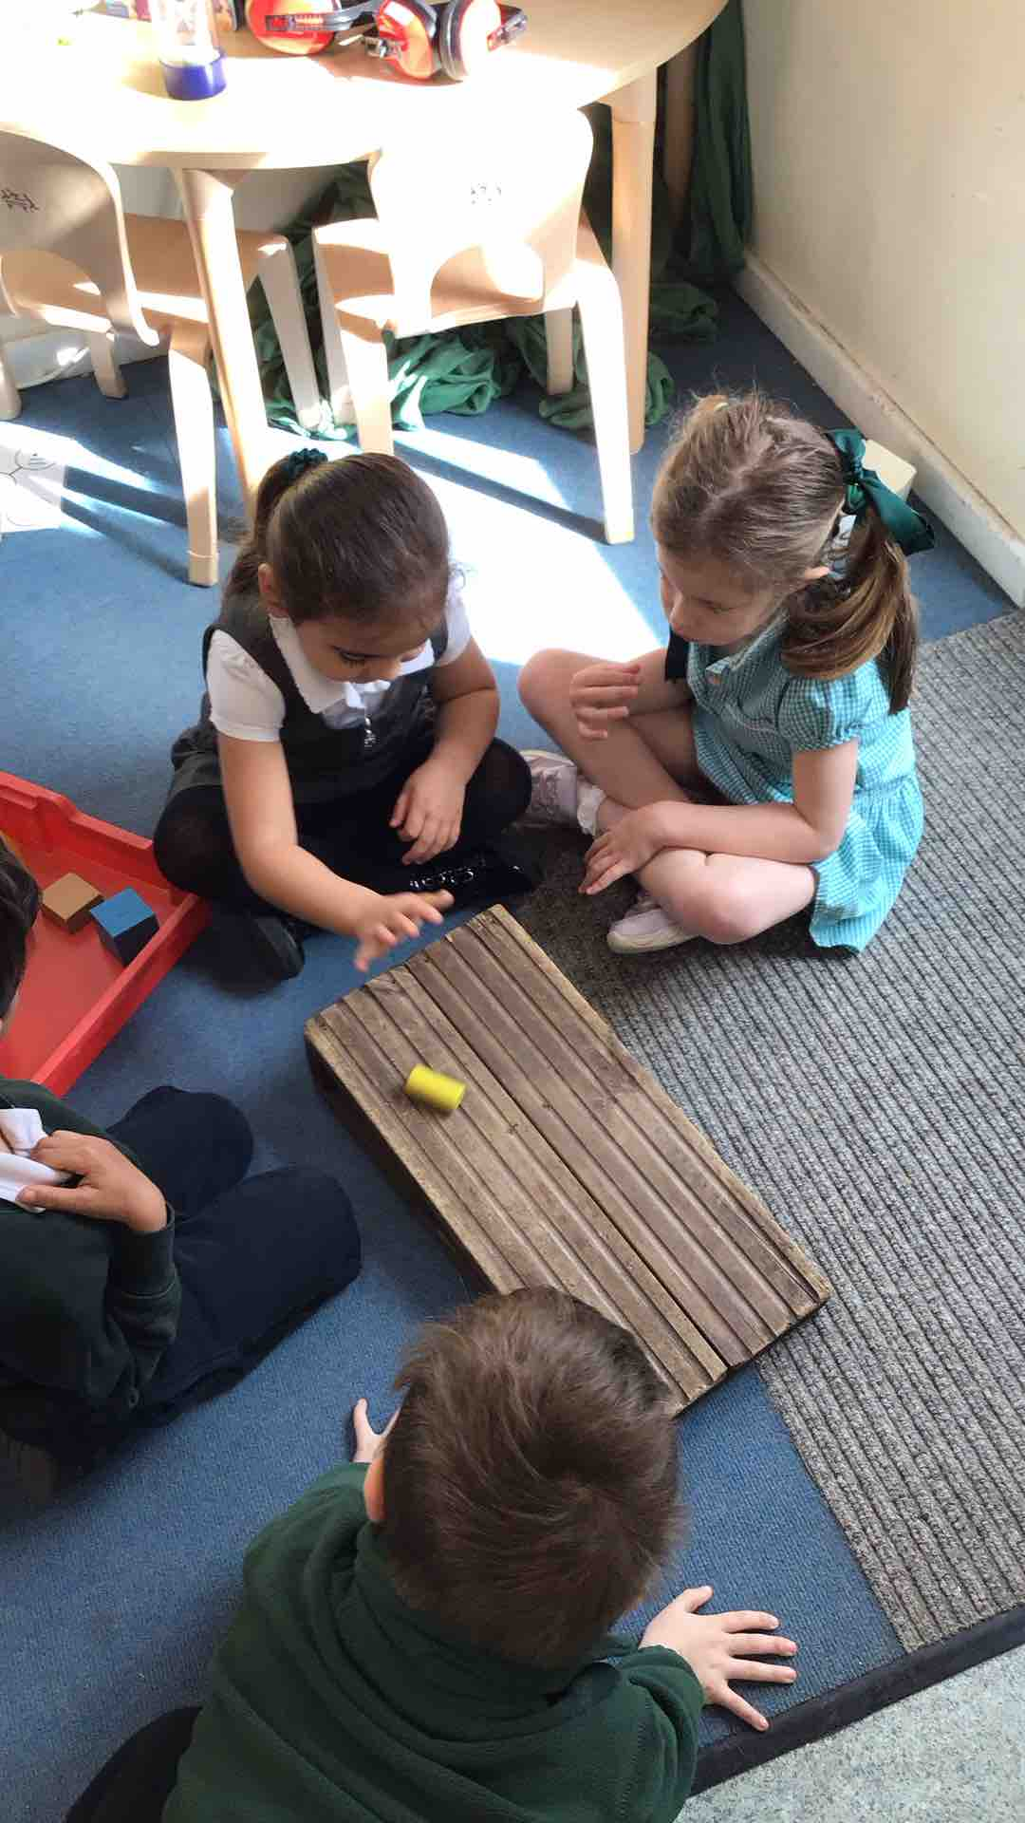
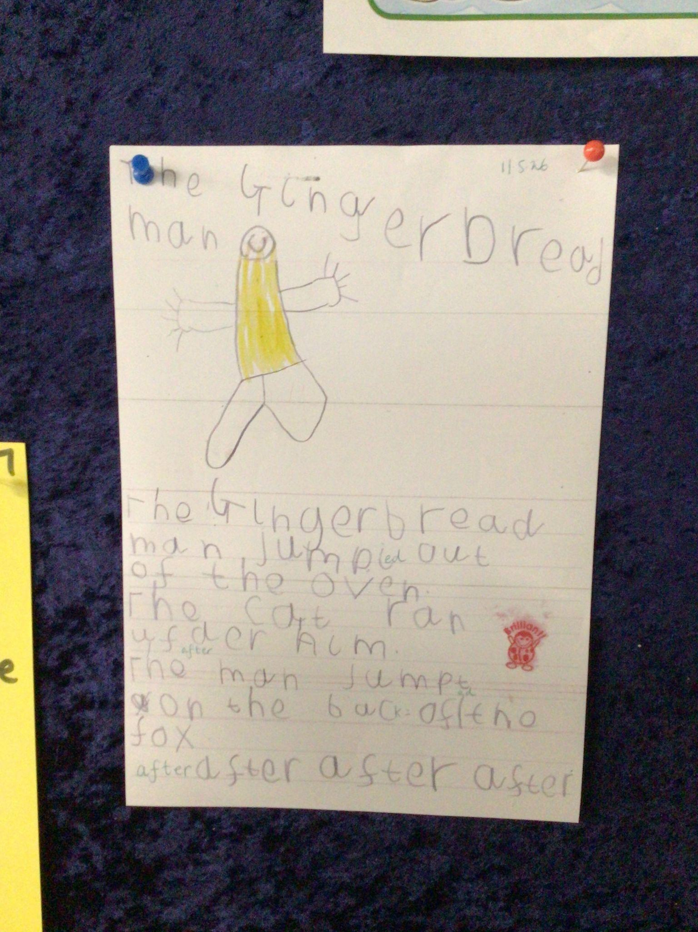
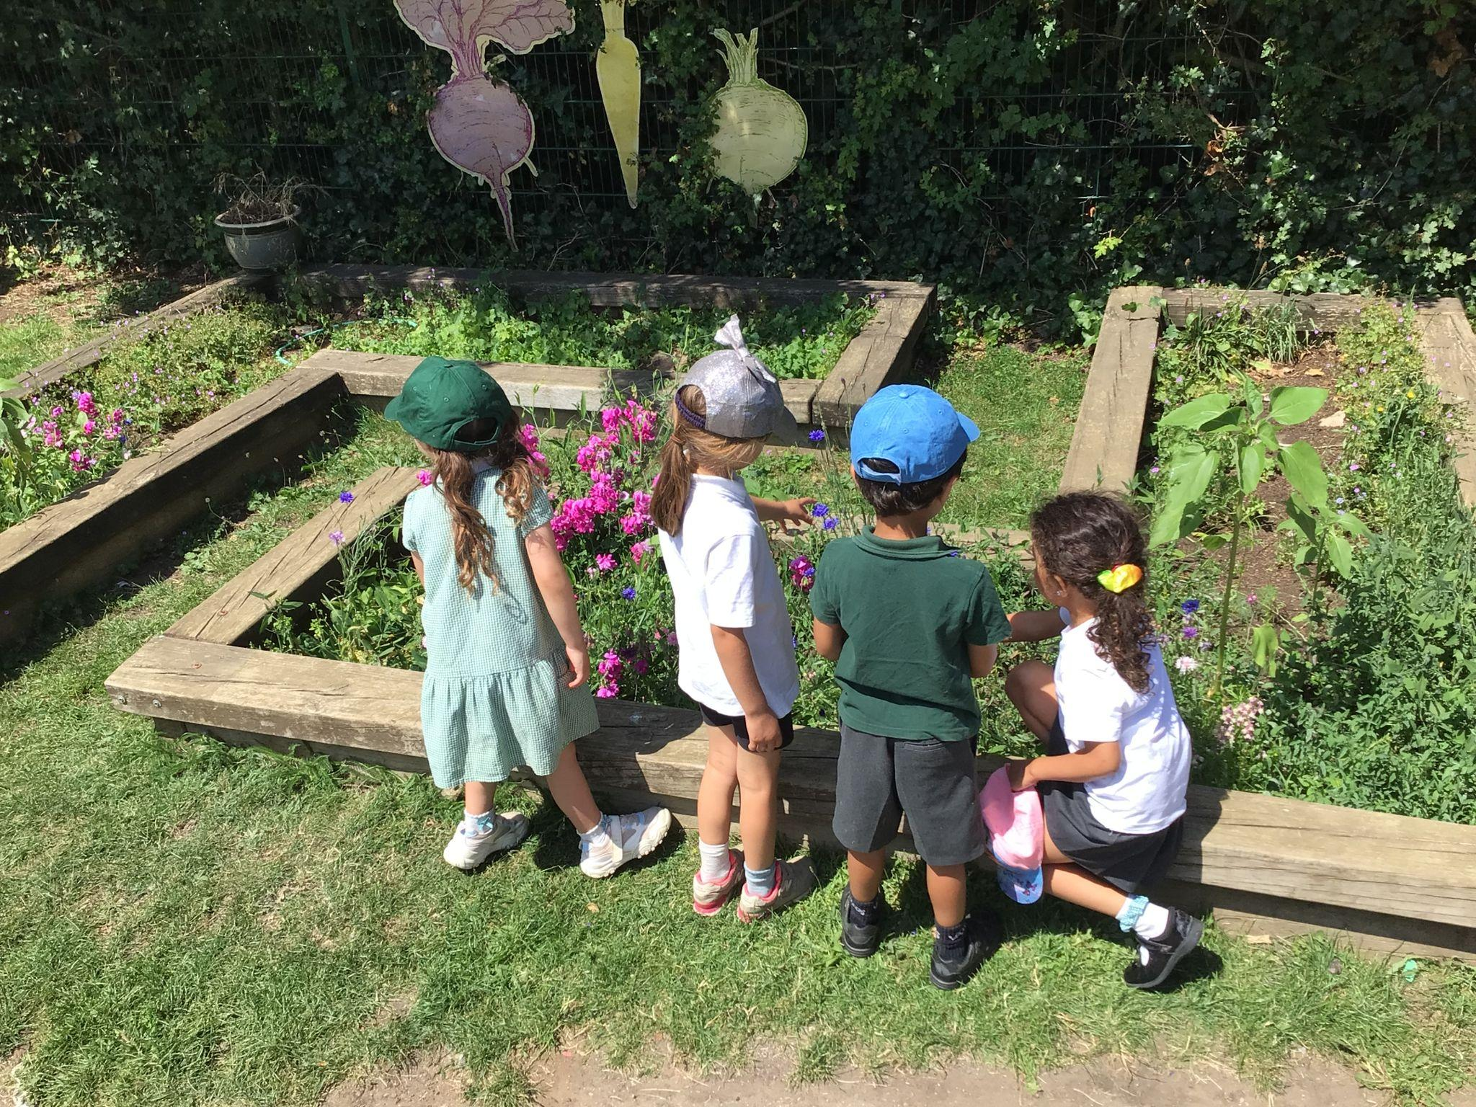
EVIDENCE ME
You will be invited to sign up to the online journal to keep an eye on what your child is doing. Post home learning images or fun activities you have taken part in.

Slide 9
WHAT DO I DO WHEN I ARRIVE ON MY FIRST DAY?
I will wait at the metal gates with my grown up until a member of staff opens them.
My grown up can walk me to my classroom door and encourage me to hang my coat up myself.
I can come into the classroom and play with my new friends.

Slide 10
DAILY ROUTINES
Morning routine – this tends to change on PE days (tbc)
8.45-8.55 | Arrive at school – Busy Fingers activities
9.00 | Welcome / Register / Choose Lunch / Calendar
9.05 | Phonics (whole class)
9.20 | Group reading / small group activities / play
10.00 | Snack available (school-provided fruit) Active Learning Free-Flow
11.20 | Maths (whole class)
11.45 | Lunchtime (Acorns only in dining room)
12.00- 1.00 | OPAL
Notes:
Insert the school’s/setting’s routine using parent friendly language and the lead person explaining what each part of the routine means.
Go through this and explain each session eg. child initiated activities and self-registration
Suggestion – add a photo of the school’s/setting’s visual timetable
Remember routines are adaptable throughout the year and change in response to the cohorts needs

Slide 11
DAILY ROUTINES
Afternoon routine – this tends to change on Fridays with a celebration
Assembly for EYFS
1.00 | Afternoon registration
1.05 | Topic Learning (Whole Class) – different focus daily e.g. literacy, PSED, Protective Behaviours, Understanding the World
1.25 | Small group / play
1.45 | Active Learning (free-flow) Milk available free for under 5’s – a letter will be in the pack
2.45 | Story / Get ready for home
3.05 | Home time
Notes:
Insert the school’s/setting’s routine using parent friendly language and the lead person explaining what each part of the routine means.
Go through this and explain each session eg. child initiated activities and self-registration
Suggestion – add a photo of the school’s/setting’s visual timetable
Remember routines are adaptable throughout the year and change in response to the cohorts needs

Slide 12
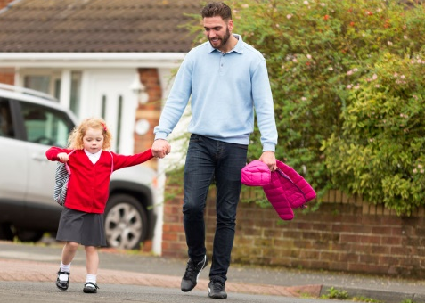

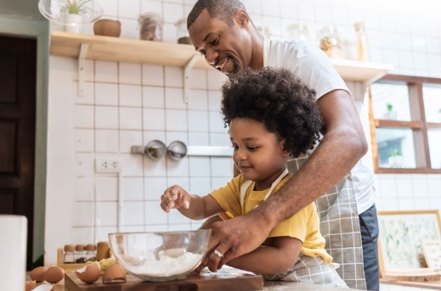

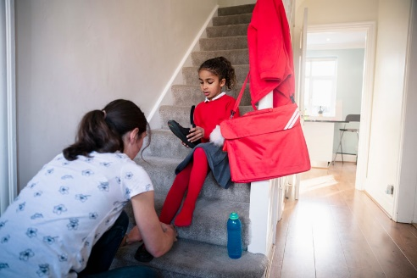

HOW CAN I SUPPORT MY CHILD AT HOME?
Communicate and talk with your child
Enjoy physical activities together
Have fun
exploring maths
Read, tell and make up stories together
Support your child to do things by themselves
Encourage your child to talk and play with others
Notes:
Explain that as the children progress through the school/setting they will be asked to help children at home with various activities (home learning), such as reading a book together. Their cooperation with these activities will be most appreciated and help their child to do well at school or nursery. Always speak of school/setting positively and if issues do occur they then need to be addressed in the appropriate manner (school/setting policy).
As you talk about each photograph explain how parents can help at home by using either your own ideas or some of the suggestions below.
Communicate and talk with your child - use every opportunity to have conversations with your child - play together, draw attention to objects in the environment, talk about and recall past experiences, cook together and encourage them to talk about their feelings. For example, talk about things that make them happy/unhappy.
Enjoy physical activities together - plan outdoor experiences such as visits to the park and walks. Encourage running, climbing, jumping, swinging and throwing games. Help the development of smaller muscles through cooking experiences, the use of playdough, building with bricks/Lego and opportunities to make marks and draw.
Fun with maths – play board or card games, count objects and compare them e.g. you have 3 and I have 4; I have more. Use opportunities at mealtimes e.g. you have 4 carrots on your plate, if you eat one how many will be left? During bath time use toys and containers that encourage filling and pouring; talking about things that are full and empty. When you are out and about draw attention to shapes and numbers in shops or in the street. Sing number rhymes together.
Read, tell and make up stories together- join the library and share books together, talk about the pictures and the print. Point out words that begin with the same letter as their own name and look for objects that begin with the same sound. Look for signs to read when you are out and about. Have a box available for your child that contains paper, notebooks, old envelopes, glue sticks, scissors and different writing tools, such as pens and pencils
Support your child to do things by themselves – let children put on their shoes/coats and do them up. Encourage them to wash their own hands, open food packets, use cutlery and say when they need the toilet or a drink.
Encourage social interactions - play together, encourage them to not interrupt, model taking turns and sharing. Model how to ask for something. Arrange times to play with other children. For example, meeting another family at the park

Slide 13

SUPPORTING INDIVIDUAL NEEDS
Our SENCO is Miss Stubbs
If you or your child’s class teacher are concerned about your child's learning and development, first talk openly together about it.
School provide a range of reasonable adjustments, adaptive teaching and additional help for children who need further support with their learning and development. This may include the support of other professionals, SEND support plans for some children, and for a small number of children, an Education and Health Care Plan (EHCP).
Parents/carers are consulted and involved in any discussions and decisions about their child.
Notes:
Insert the name and photo of the SENCo
If you are concerned about your child's learning and development discuss this with the class teacher or their key person
The school's Special Educational Needs Coordinator (SENCo) supports children who need additional help
Children are helped if they need support with toileting or continence issues
Explain that, after consultation with parents/carers, the school/setting can provide a range of additional help for children who need further support with their learning and development, this may include the support of other professionals, individual learning plans and for a small number of children an Education and Health Care Plan (EHCP). Parents are consulted and involved in any discussions and decisions about their child.
Explain how the school/setting helps children with toileting and continence issues.
See the HfL Incontinence Guidance (Coping with Incontinence - Supporting children with continence issues in early year’s settings and schools) which is provided as part of the transition materials.

Slide 14
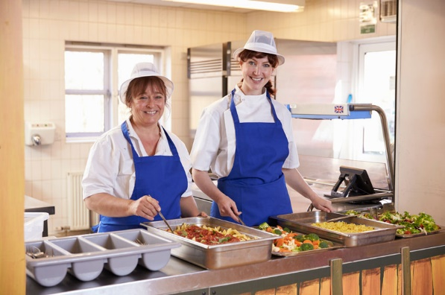
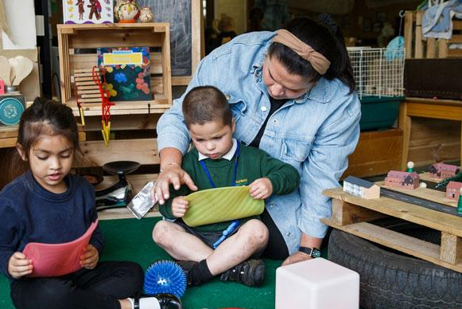

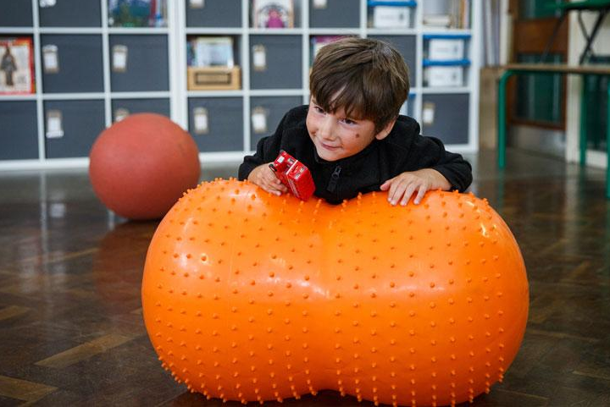
SUPPORT FOR YOUR CHILD
UNIVERSAL FREE SCHOOL MEALS
Currently, children in Reception, Year 1 and Year 2 in state funded schools receive a free school lunch. This is government-funded and all children are eligible, respective of parental income or situation
Schools receive additional funding for a number of eligible families such as
- Those with financial situations that qualify for free school meals
Child looked after by local authority or in private foster care or has been adopted
The school require all parents to complete the appropriate form to check eligibility.
Family circumstances also change so it’s worth checking again if this happens.
https://www.hertfordshire.gov.uk/services/schools-and-education/at-school/free-school-meals/free-school-meals.aspx
If your child is eligible, the funding can be used in a range of ways to improve their educational outcome, including enrichment opportunities. The school is very discreet with the confidential information you provide and the way in which support in provided.
Notes:
Universal Free School Meals
Currently, children in Reception, Year 1 and Year 2 in state funded schools receive a free school lunch. This is government-funded and all children are eligible, respective of parental income or situation.
Schools receive additional funding for a number of eligible families such as
- Those with financial implications that qualify for free school meals
Children with families serving in the regular armed forces or have been registered as a ‘service child’ in the school census since 2011 or a child who has lost a parent/carer serving in the armed forces
Child looked after by local authority or in private foster care or has been adopted
The school require all parents to complete the appropriate form to check eligibility. (Provide at the induction)
If your child is eligible, we will, in liaison with parents/carers, allocate the funding to improve their educational outcomes. The funding can be used in a range of ways, including providing specialist equipment/services (for example, speech therapy), enrichment opportunities or in-session support. The school is very discreet with the confidential information you provide and they way in which support in provided.

Slide 15







KEEPING CHILDREN SAFE IS EVERYONE’S RESPONSIBILITY
Notes:
Go through each point and give information related to the practice in your school and how you as a school help to keep children safe.
Safeguarding/Child protection Children have a right to be cared for and protected and that protecting them is everyone’s responsibility.
Explain that it is everyone's duty to respond to concerns about a child's safety. All staff are trained and follow procedures in the schools/settings Child Protection policy (copy on the website).
Mobile Phones explain why mobile phones must not be used in school/setting. Talk about why it can be dangerous to share children’s photographs on the internet and your school/setting policy regarding taking photos at school/setting events. Explain how the school/setting keep the children safe when using the internet. Tell parent’s where to find the policy (school/setting website).
Road safety and parking – promote walking to school but if using a car explain safe places to park. Talk about teaching children to cross the road safely.
Drop off and collection procedures - a password is required if unknown adults are collecting. Talk about making sure that gates/doors are closed and ensure that children hold an adult’s hand when leaving the building.
Accidents - explain how the school manage accidents and that first aid is administered in line with the school/setting policy. Talk about the fact that accidents are recorded and how risk assessments are undertaken to manage potential hazards.
Existing injuries - explain that if a child arrives at school/setting with an injury, as part of safeguarding procedures parents/carers will be asked to complete an 'Existing Injury' form.
First Aid – use your school’s First Aid policy to explain how and when you administer first aid. For example, talk about staff being first aid trained and that parents are asked to sign injury forms. Reassure parents that they would be contacted regarding any serious injuries that require further medical attention such as a head injury.
Covid 19 – Copy this slide and share your current procedures for Covid-19

Slide 16




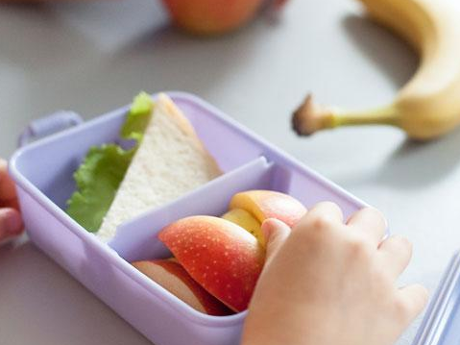
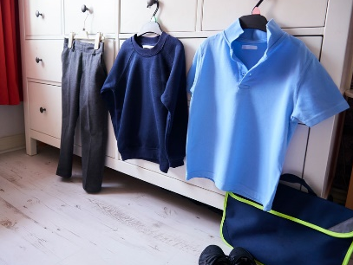


KEEPING CHILDREN SAFE IS EVERYONE’S RESPONSIBILITY
You…
Notes:
Go through each point and give information on how parents/carers can help support the school to keep children safe
Children who are unwell – explain the school policy keep a child off school at least 48 hours after the last attack of vomiting and diarrhea (quote NHS guidelines) informing the school/setting regarding contagious/infectious illnesses
Medication –policy on administering medication (for example, antibiotics or paracetamol) parents/carers responsibility to inform the school if their child is taking or requires any type of medication.
Individual medical needs –vital for parents to share information about their child’s individual medical needs such as allergies so that a Health Care Plan (HCP) can be completed with the parent/carer
Explain the healthy eating policy and share examples of a healthy packed lunch. Remind parents to name lunch bags, containers etc. Talk about arrangements for snack in the early years and whether parents contribute. Explain the school’s procedures for children accessing drinks of water. Talk about the policy regarding bringing in food for a child’s birthday.
Discuss possible allergies and how these are managed in school. For example, a ‘no nut policy.’ Other dietary requirements such as dairy/religious/veganism
Emphasise the importance of regular attendance, 96% attendance expected. Explain how it helps children to have a good routine and that children who attend regularly, settle more easily and make better progress with learning and development.
Children can sometimes be unwell and in which case they need to rest at home.
Explain the school’s/setting’s procedures and policy regarding the parent’s responsibility in alerting the school/setting if a child is absent or if they change address and contact details.
Talk about how parents will be informed about their child’s attendance and any incentives for good attendance (if applicable)
Uniform –what is needed and where it can be purchased, including a book and PE bags (some families new to our education system may not know what is expected). Alert parents to the availability of secondhand uniform. Talk about suitable types of shoes and that all clothing must be named including footwear, coats, scarves and gloves.
Wellington boots –to be kept at school/setting as children play outside in all weathers (including the rain). These must be named.
Outdoor policy - Clothes for cold weather – emphasis the importance of outdoor learning and that that there is no such thing as unsuitable weather just unsuitable clothing. Give examples of appropriate clothing for outdoor play in cold weather.
Clothes for warm weather – explain the school/setting’s sunscreen policy. Advise parents to provide sunhats, cotton clothing that protects the child’s arms. Explain how children have access to drinks of water.
Remind parents that everything needs to be named.

Slide 17

HOW WE COMMUNICATE WITH YOU
Communication is so important. It plays a huge role in ensuring that you are regularly sharing information with us to best support your child.
We do this by…
Daily chats at drop off and pick up time
Termly parent consultation meetings
Stay and Play session
Newsletters
Notice board
Email
School Website
Notes:
Edit to suit what is in place in your school/setting
Add your website address, facebook page, twitter account details

Slide 18
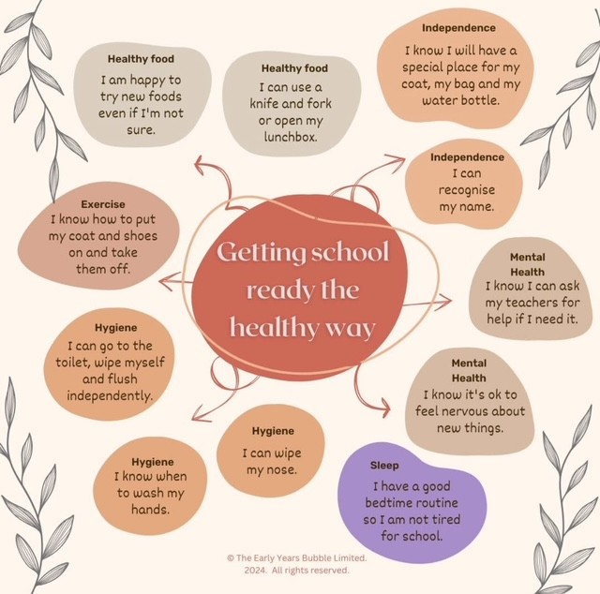
SCHOOL READINESS

Slide 19
FUTURE DATES FOR YOUR DIARY
Stay and Play transition morning | Thursday 9th July 10am- 11:30am
Family meetings | Thursday 3rd and Friday 4th September
Children attend for half days | Monday 7th and Tuesday 8th September
Children attend for full days | Wednesday 9th September onwards
PTA picnic | Saturday 12th September 2pm- 4pm
EYFS Curriculum Meeting | To be confirmed
Notes:
Insert important dates for example transition visit dates; sports day; any future parent events
Consider hosting curriculum workshops in the autumn term with the final weekly routine highlighting P.E. days etc. and focusing on supporting specific areas of learning such as phonics, early reading and writing and early maths

Slide 20
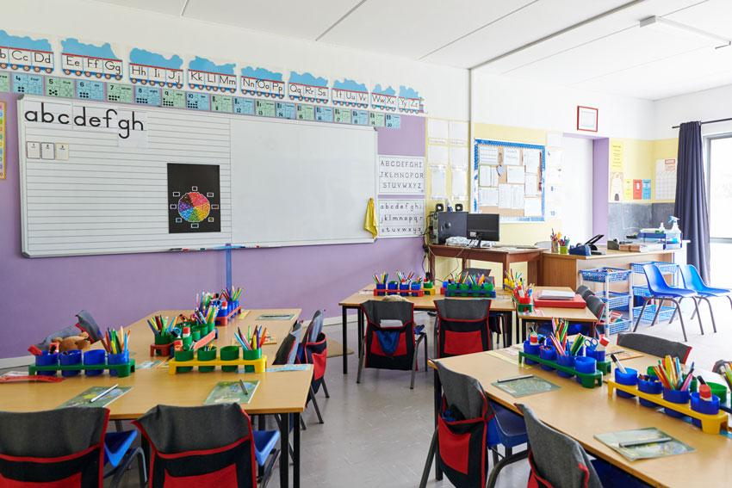
BEFORE YOU GO…
Please sign up for your family meeting when you are in your classroom.
Notes:
Activity Encourage parents to take photos that can be shared with their child. Ensure that photos/information of children are removed/covered in the setting

Slide 21

QUESTION TIME
No question is a silly question…
If anyone has anything they would like to ask please feel free to
Notes:
Ensure you have 10 minutes for any questions
Remind parents that if something is worrying them now or when then child starts school/nursery it is important that they discuss their concerns with the class teacher or child’s key person.
If you have any questions personal to your family there will be an opportunity to ask these at the home visit or at a specially arranged meeting.
Mention use of parent volunteers and how you welcome this but DBS clearance will need to be completed. Explain how they could do this if anyone shows interest.

