Slide 1


Metacognition
Parent Workshop March 2022

Slide 2
Outline
What is metacognition and why is it important?
How do we support pupils to develop metacognitive strategies at Oakwood?
How can you support your children’s metacognition at home?

Slide 3
What is metacognition?
Understanding how we learn
Planning tasks and strategies to aim for success
Taking notice of whether we are on track and making changes if something isn’t working
Reflecting on what worked and what we will change next time to be even better

Slide 4
Why is metacognition important?
Better learning outcomes
More confident, independent learners
Better learners in terms of skills they will use throughout education
Benefits in terms of holistic development

Slide 5
How do we support pupils to develop metacognitive strategies at Oakwood?

Slide 6






Asking metacognitive questions
“What’s your top tip for…”
“How are you helping yourself to learn?”
“How did that mistake help you learn?”
“What can you improve?”
“What helped you achieve success?”
“Where can you look to help you?”
“What have you missed?”
“Why did you make that mistake?”

Slide 7
“If you don’t know how to start – which is sometimes the hardest part – you can picture how the character is feeling. Or start with a question or thought the character might be having.”

Slide 8
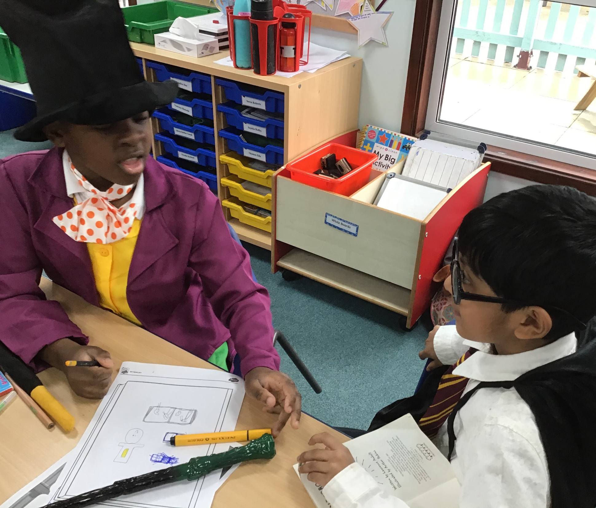
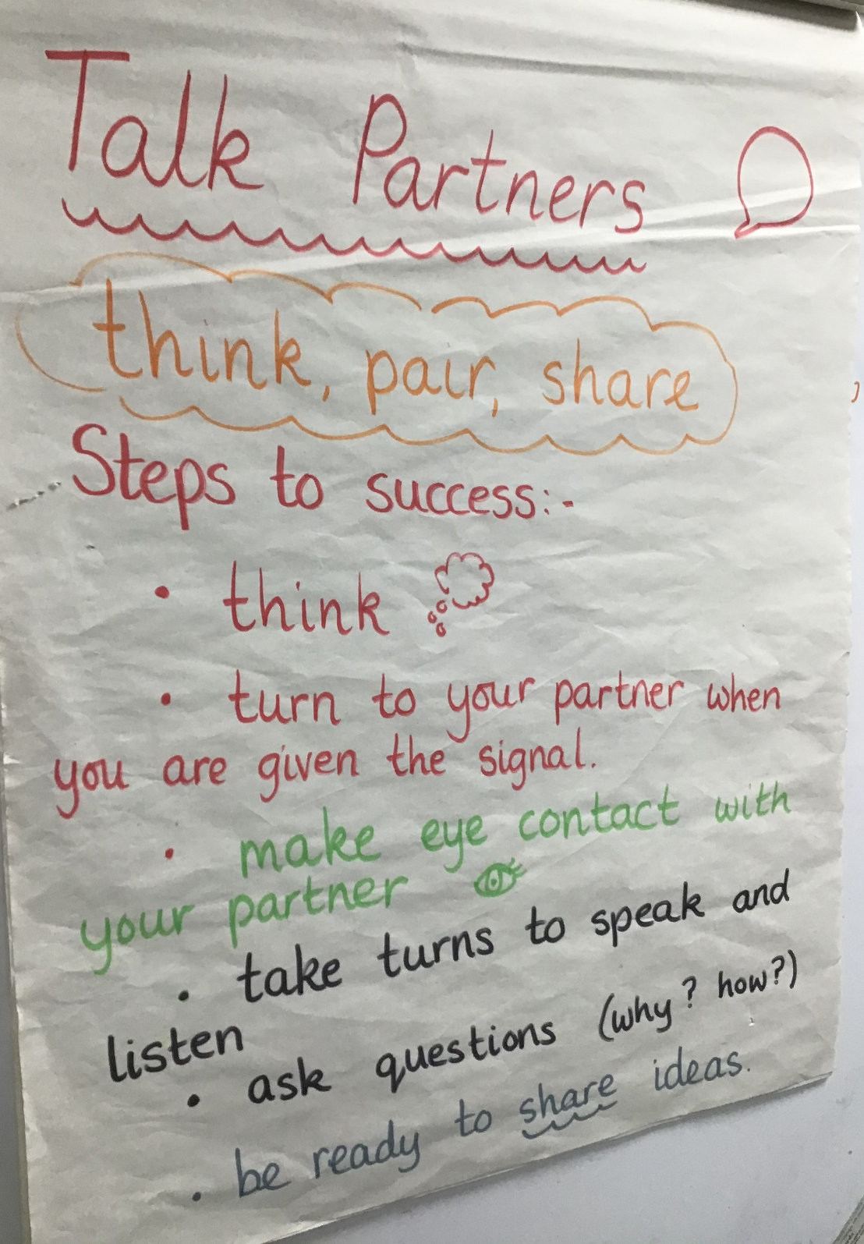

Slide 9
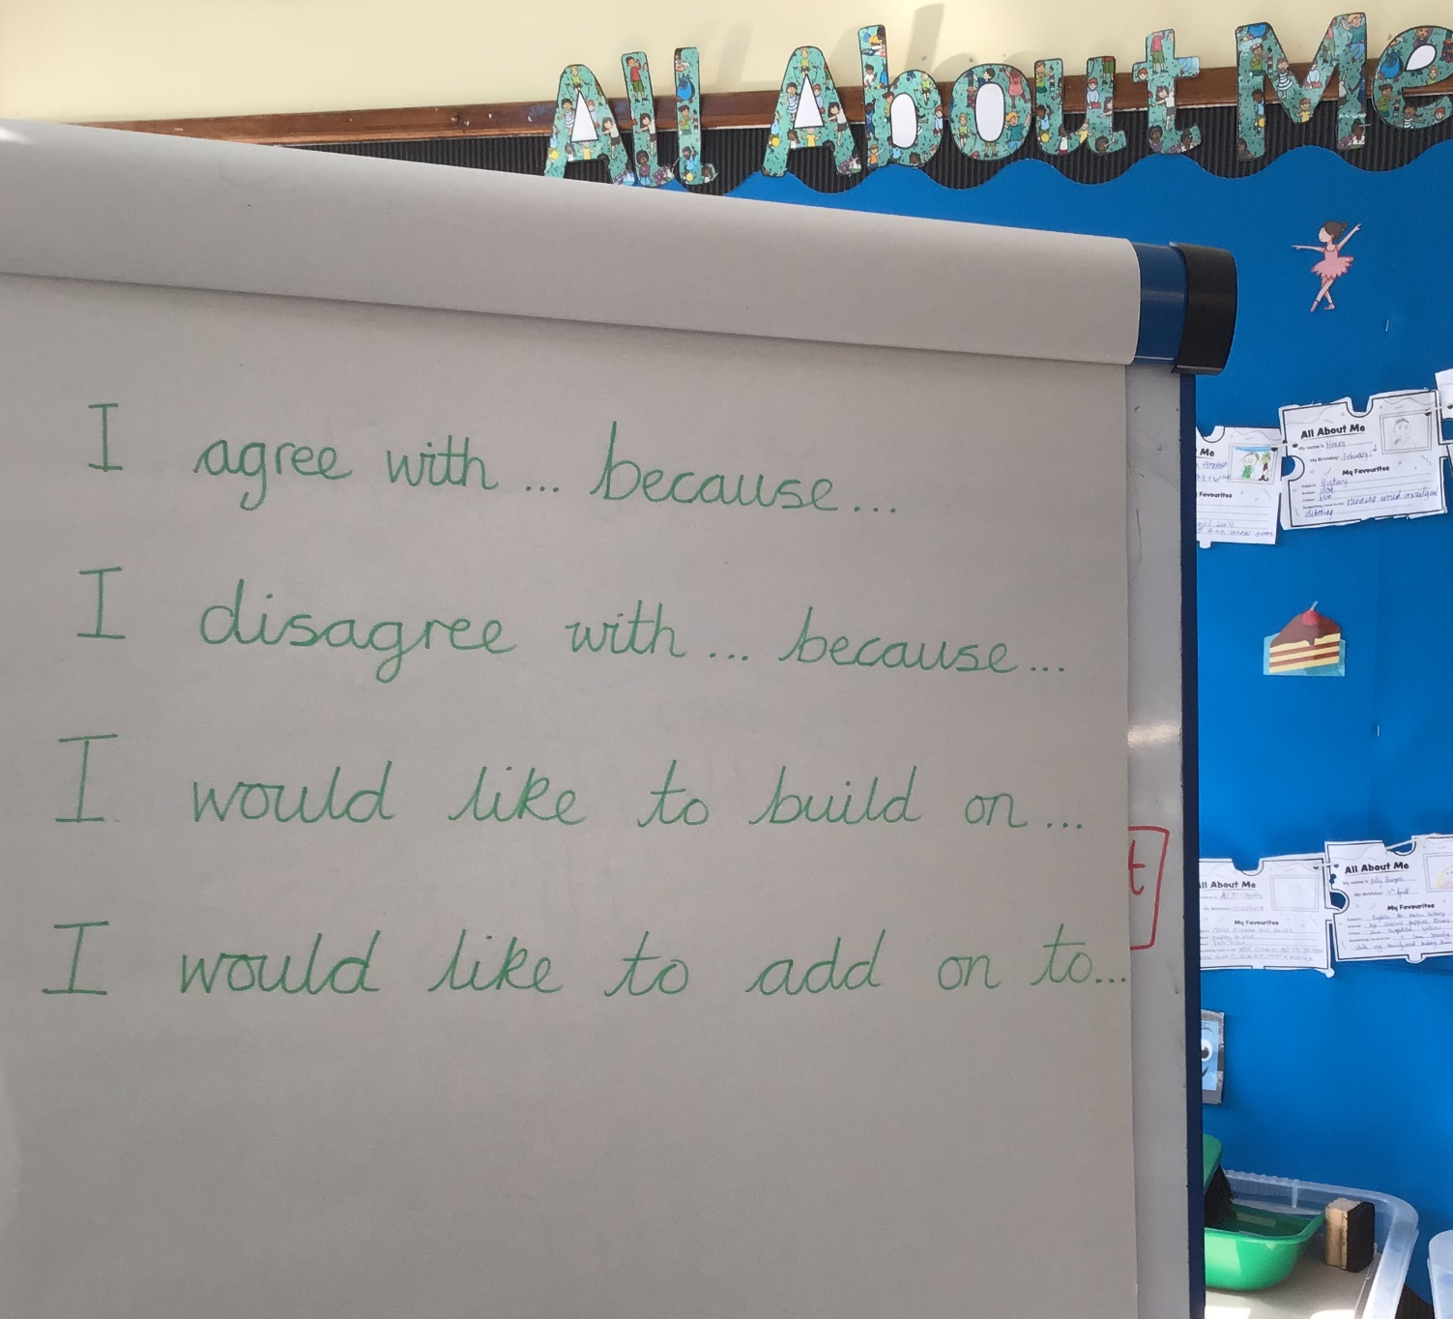

Slide 10

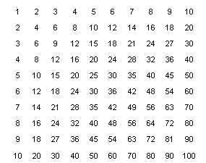

Supporting pupils’ independence: encouraging pupils to notice what they can use to help them.
“Three before me.”

Slide 11
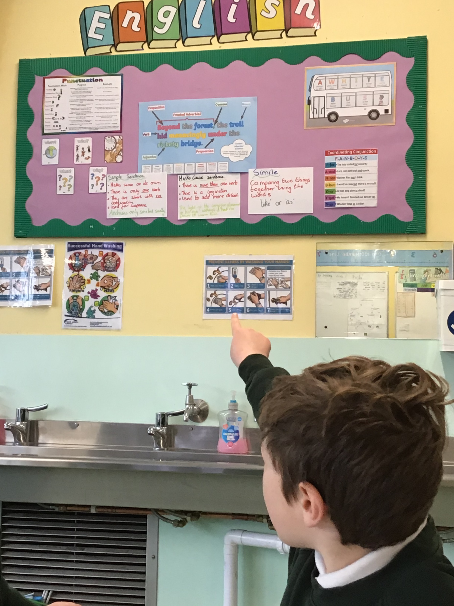
During a lesson on writing speech, this pupil used the English working wall to help him identify the term “inverted commas.” He explained to his partner that they could use the working wall to help them.

Slide 12
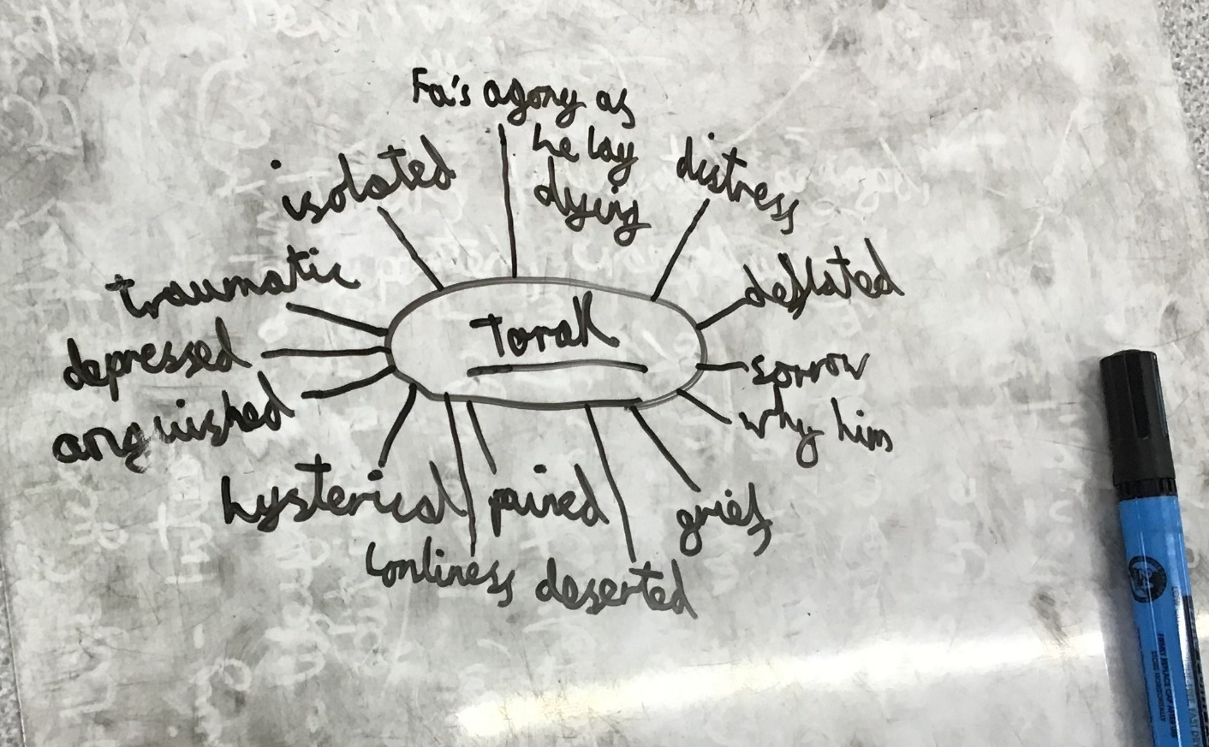
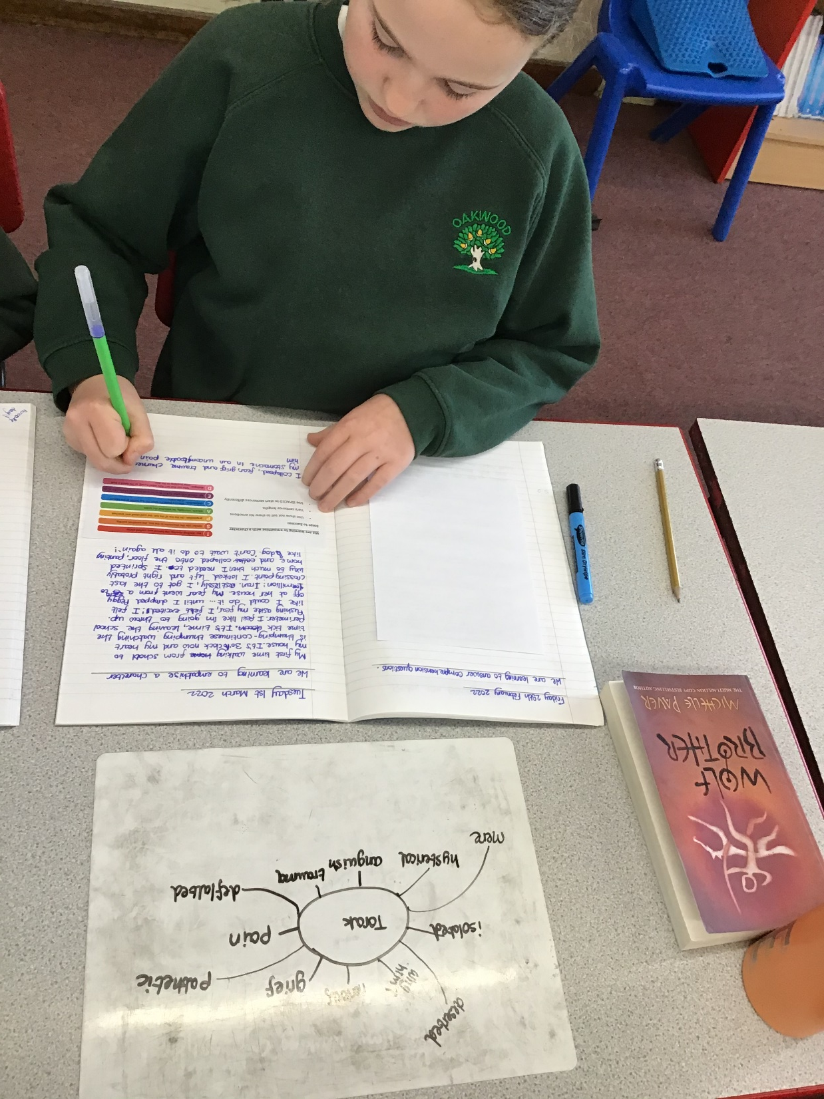
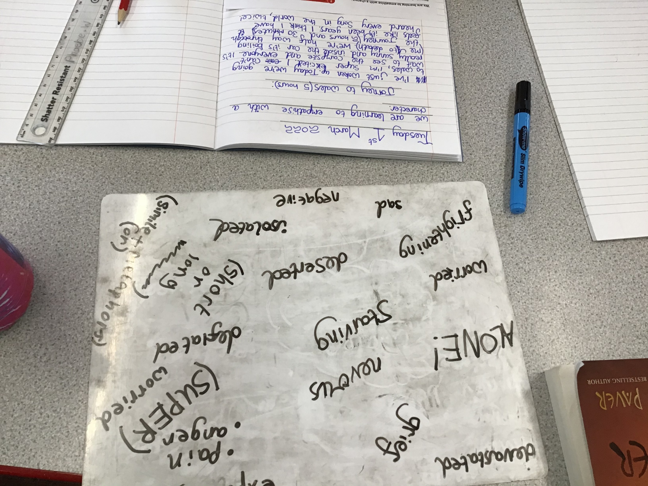

Slide 13
“It has all your different ideas and notes. You can magpie ideas from other people and then it becomes a more powerful piece of writing.”
(Year 6 pupil talking about how using a mini-whiteboard can help with learning.)

Slide 14
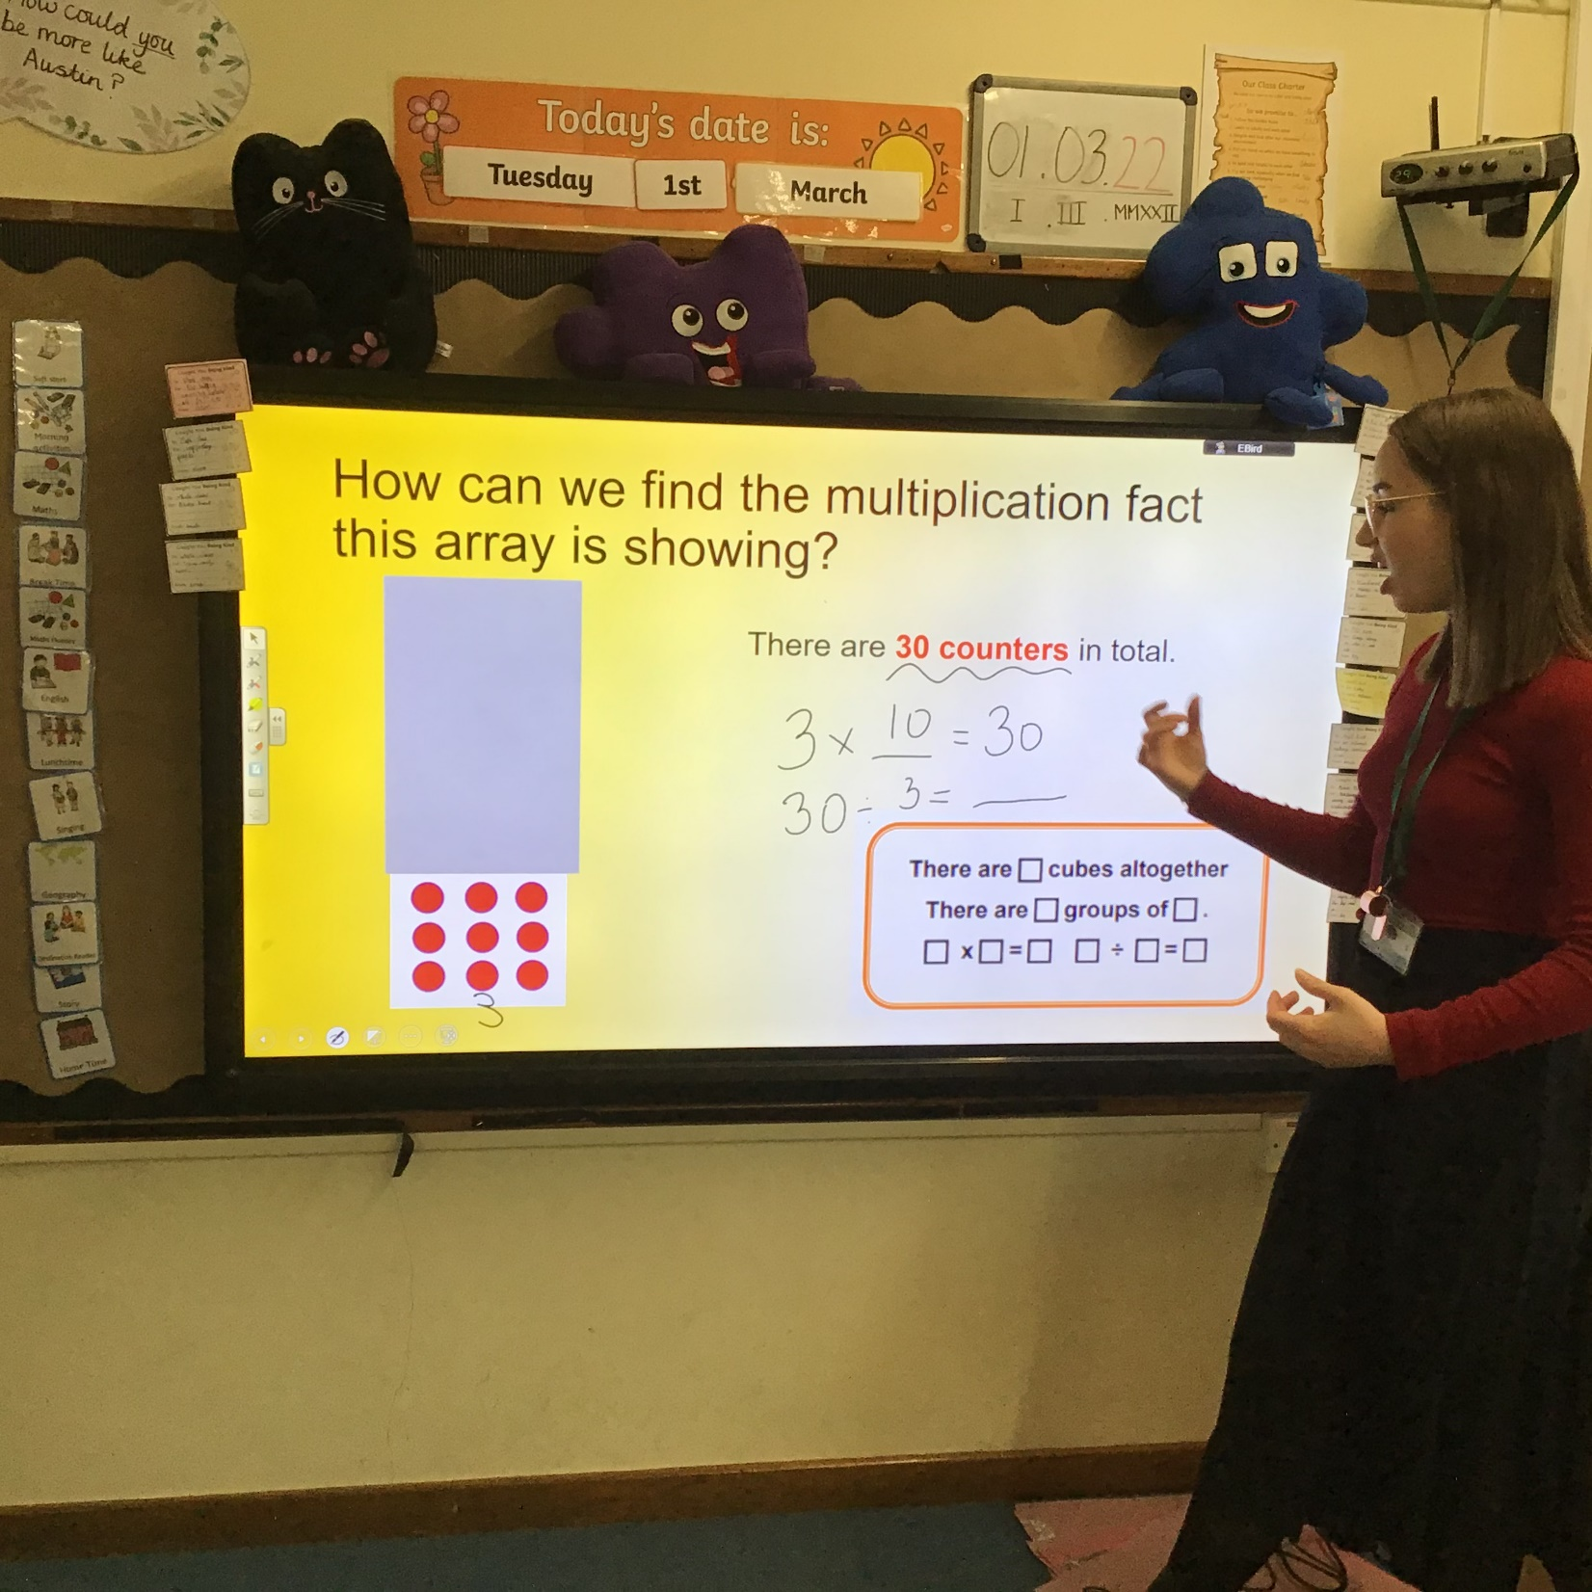
“There are two methods. You can choose whichever way works best for you.”

Slide 15
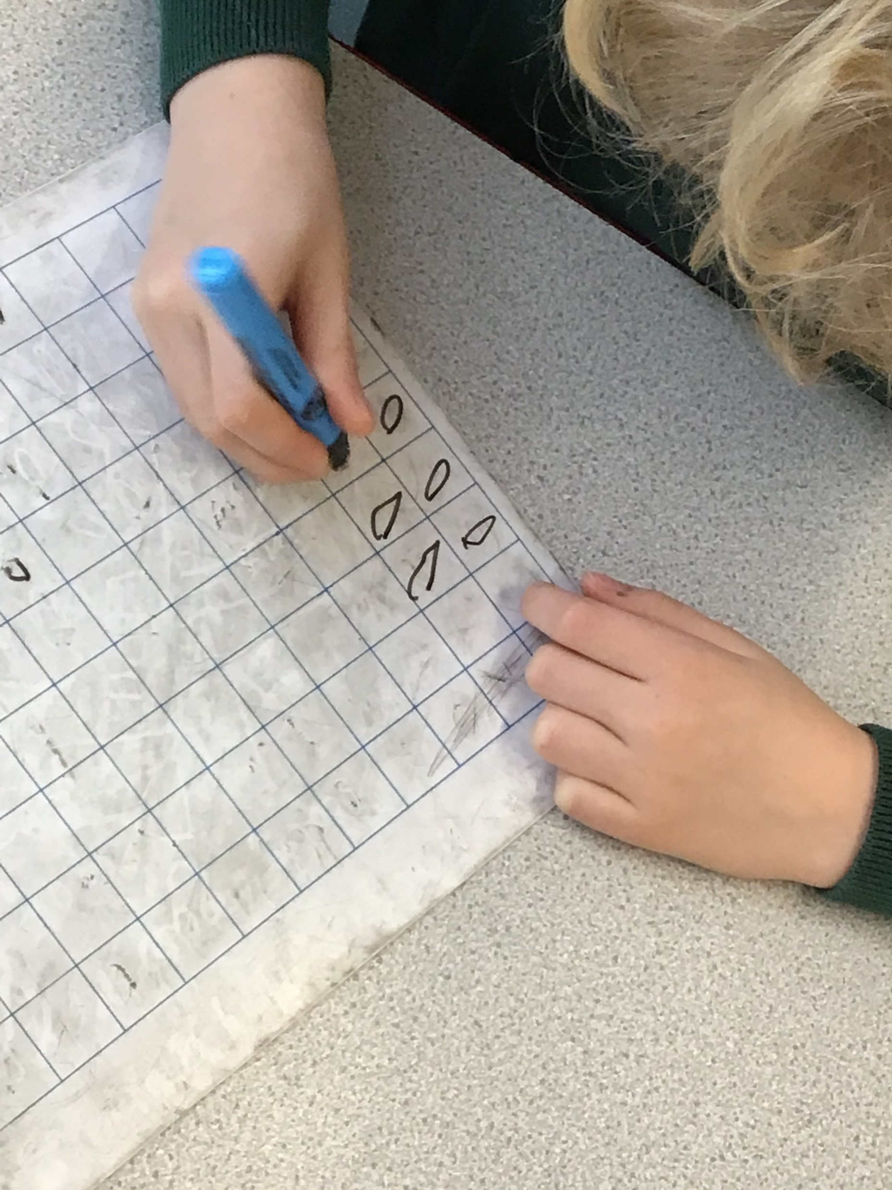
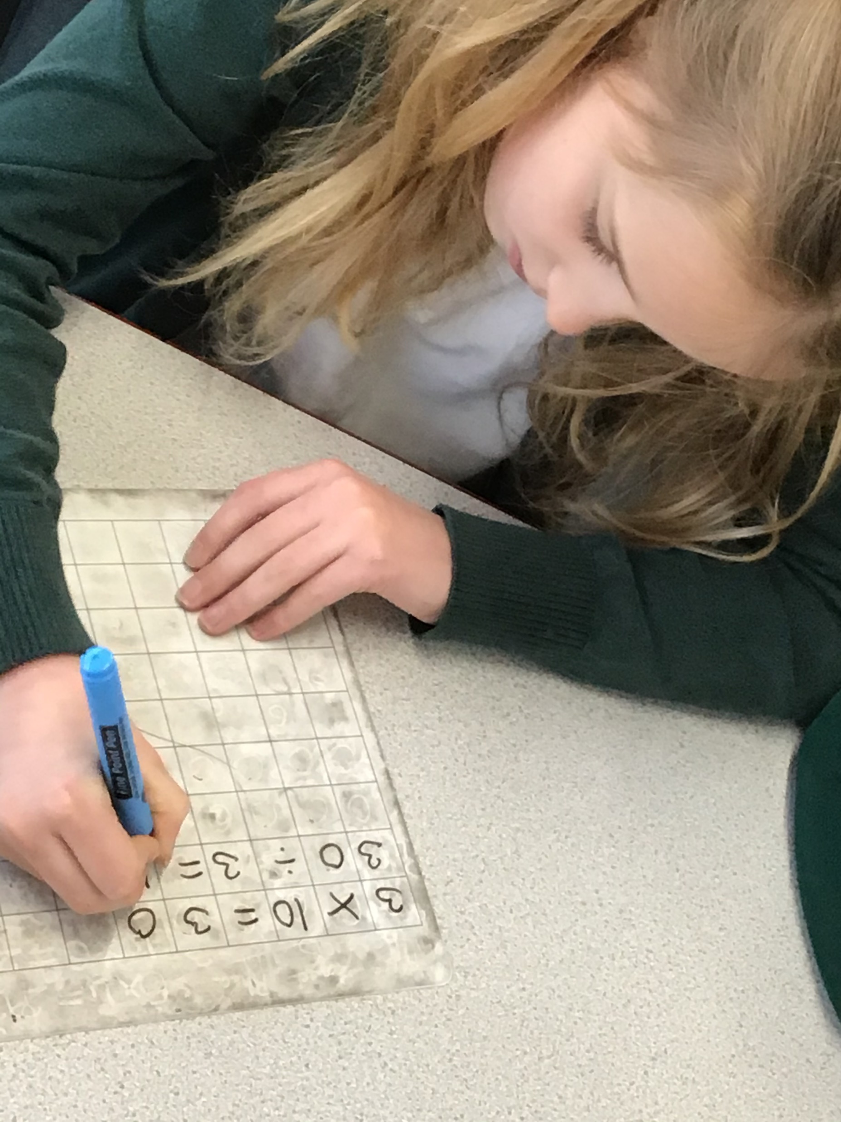

Slide 16
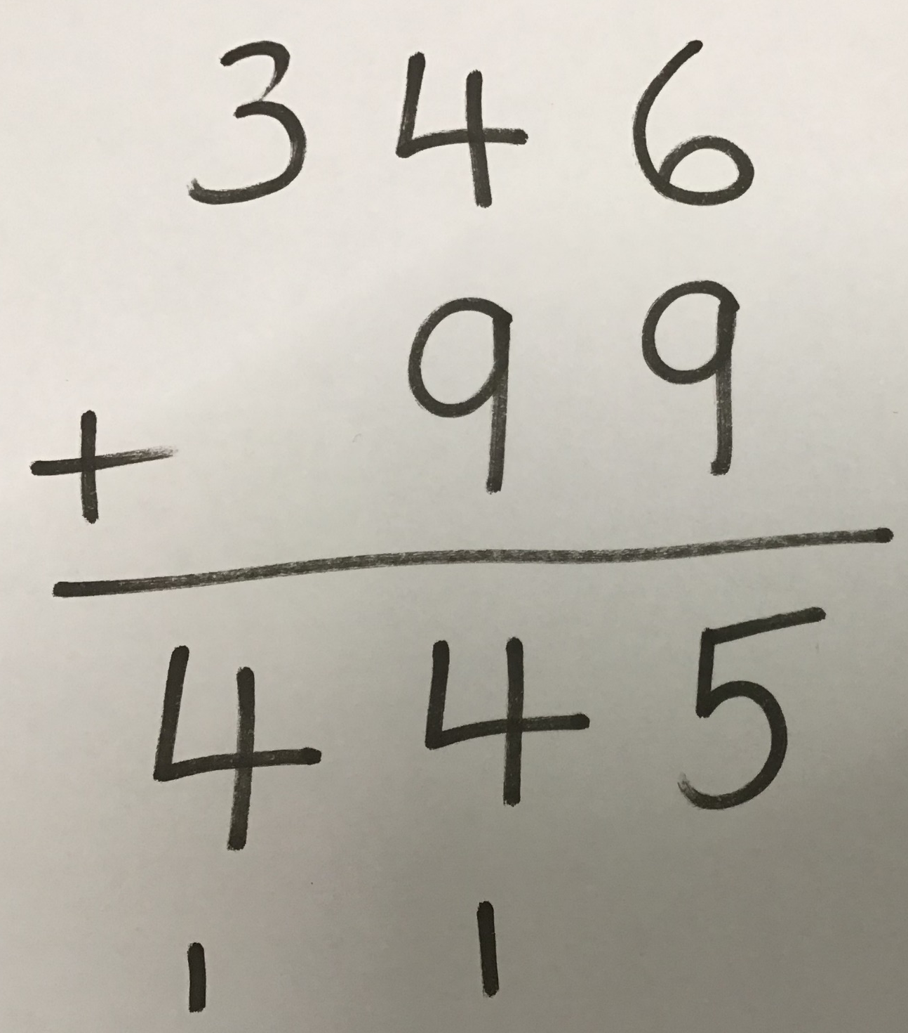
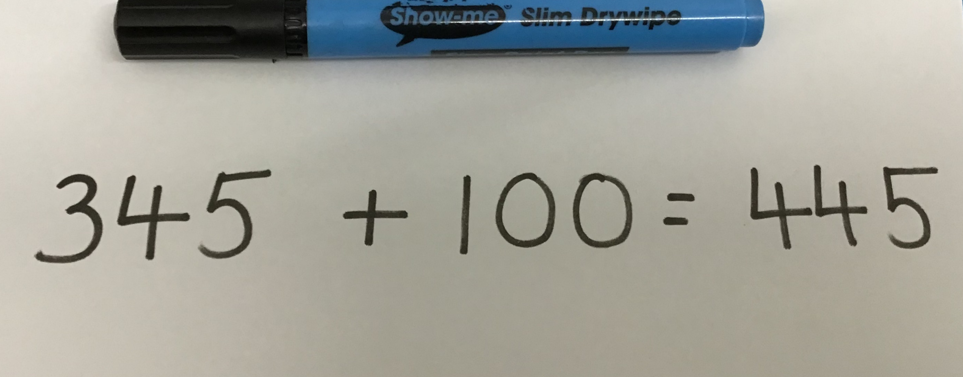
346 + 99 =

Slide 17
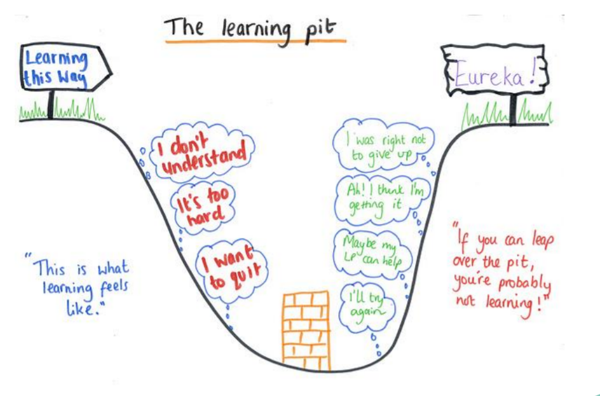

Slide 18
How can you support your children’s metacognition at home?

Slide 19
Model your own thought processes
Encourage independence
Ask questions to encourage thinking and problem solving
Allow your children to make mistakes
Encourage pupils to take ownership of their own learning

Slide 20
Asking metacognitive questions
“What’s your top tip for…”
“What was curious or interesting today?
“How did that mistake help you learn?”
“What can you improve?”
“What helped you achieve success?”
“What was confusing today?
“Where can you look to help you?”
“What have you missed?”

Slide 21

Learning is the journey, not the outcome

Slide 22
“I’m rubbish at this!”
“I give up!”

Slide 23
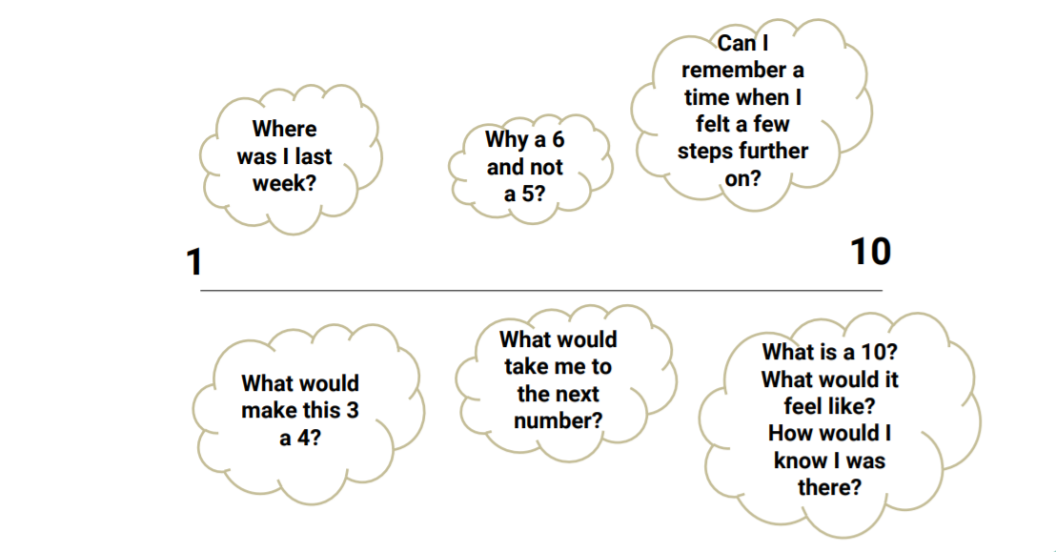

Slide 24
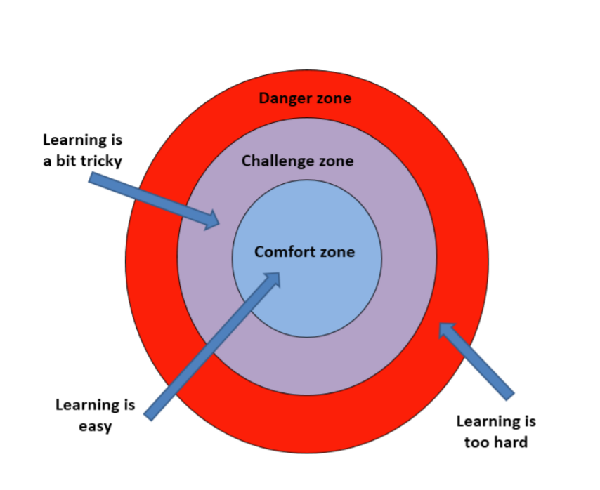

Slide 25
Asking metacognitive questions
“Which parts are you sure about and which parts are you not sure about?”
“What did you use in class to help you?”
“Have you ever done a task like this before?
“What strategy could you use?”
“How did you do it in class?”
“What have you missed?”

Slide 26
“I’ve finished!”

Slide 27
Questions?

