Slide 1
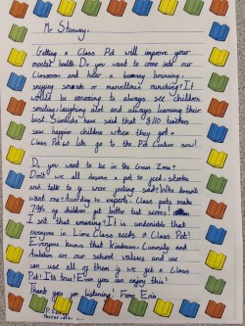
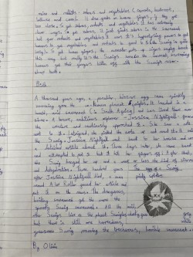
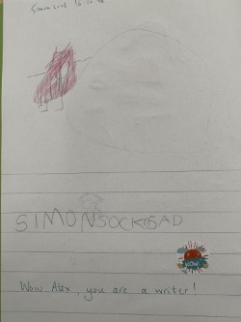
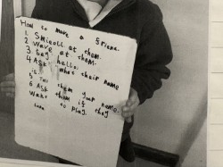
Handwriting and Spelling Presentation January 2026

Slide 2
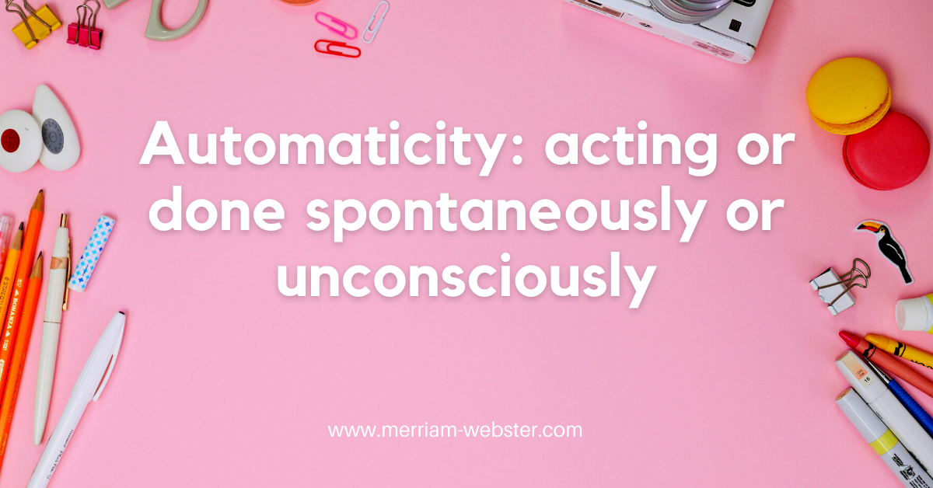


Slide 3
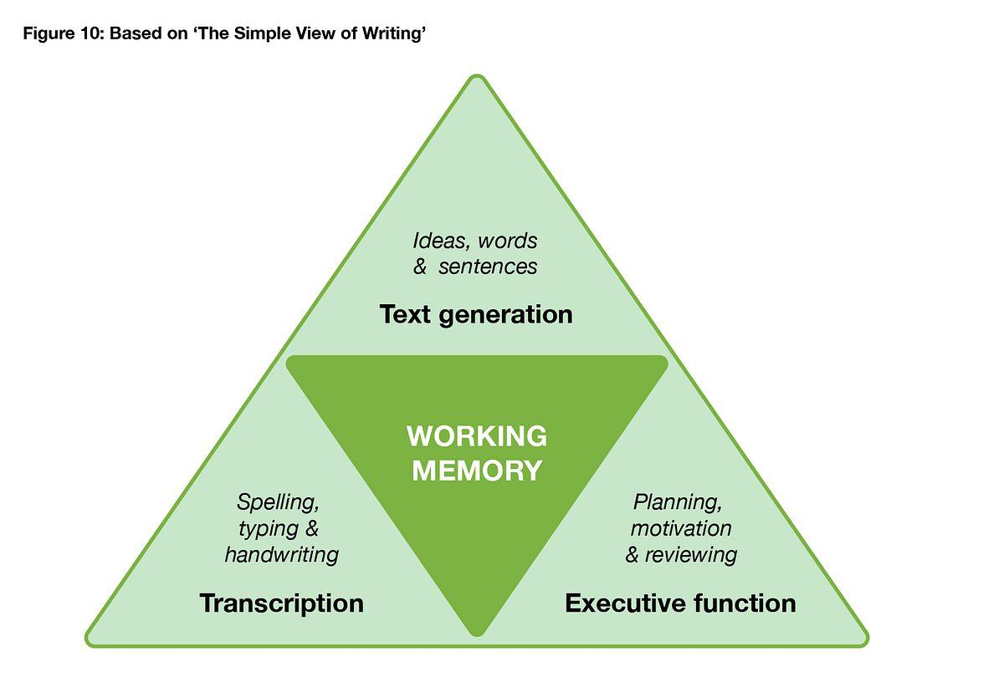
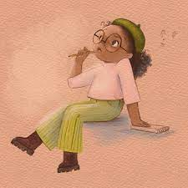
The EEF says: ‘If children have to concentrate to ensure their handwriting and spelling is accurate, they will be less able to think about the content of their writing.’
Illustration: Vashti Harrison

Slide 4
EYFS
Reception
For the early learning goal for Writing, children at the expected level of development will:
• write recognisable letters, most of which are correctly formed
• spell words by identifying sounds in them and representing the sounds with a letter or letters
• write simple phrases and sentences that can be read by others

Slide 5

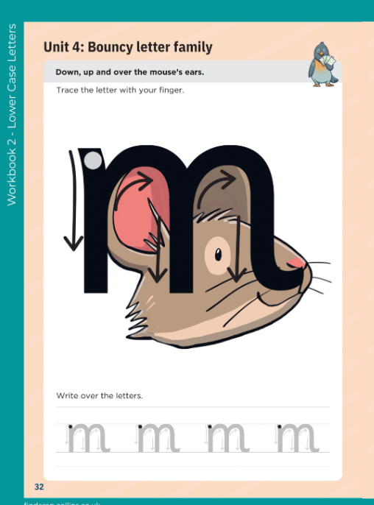
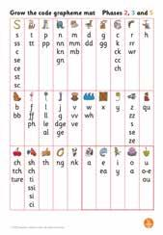
Spelling & Handwriting in Reception
Daily Little Wandle Phonics lessons are where the children learn to read and spell. They are taught a new sound of the day and then read and spell words using taught sounds/phonemes that the children write as graphemes. Children practise writing tricky words. They also learn how to write simple sentences, breaking/segmenting words down into their separate sounds at the end of each lesson.

Slide 6
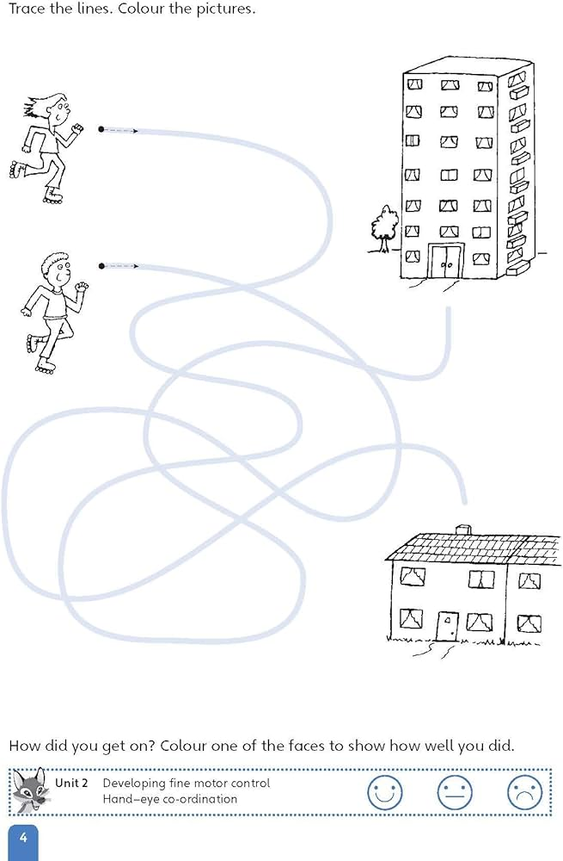
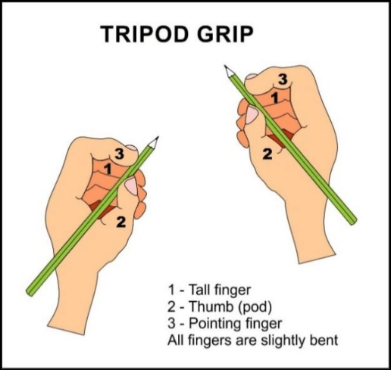
Spelling & Handwriting in Reception
Handwriting is taught in groups where the children start to learn how to sit at a table correctly, hold a pen or pencil using a tripod grip and practise their fine motor skills and letter formation.

Slide 7
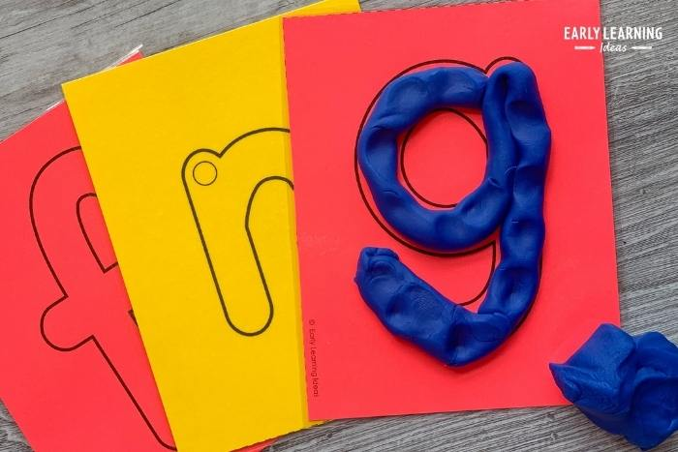
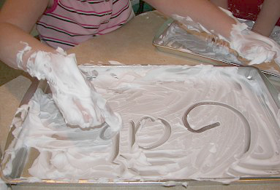
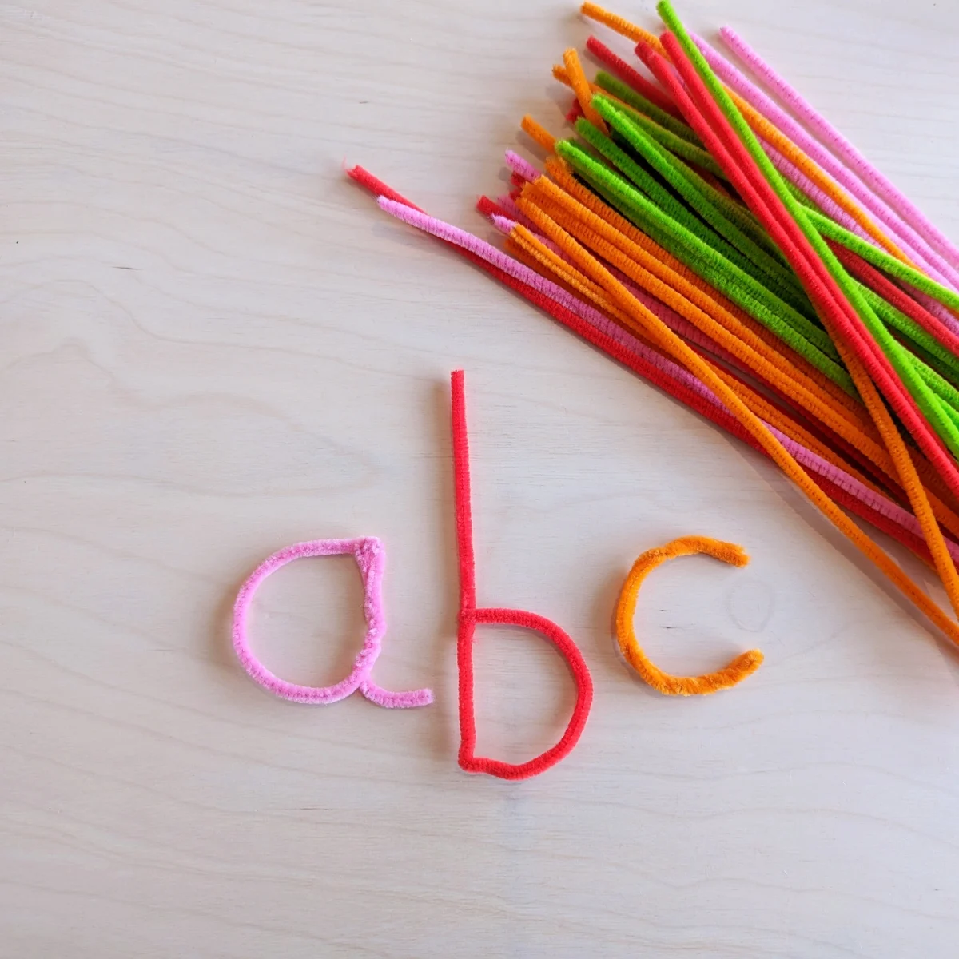
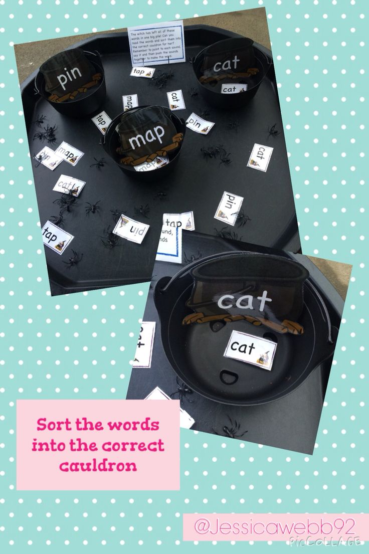
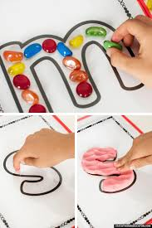
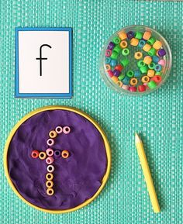
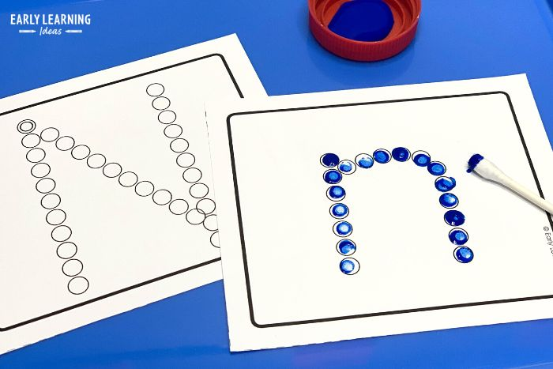
Mark making tools are available for the children daily in the Reception environment to develop fine motor skills alongside more formal writing such as labels, lists, notes or stories.
How can I create a positive learning environment and make practising handwriting fun for my child?
Use a range of sensory materials: play dough, shaving foam, paint, beads, pipe cleaners, chalks…

Slide 8
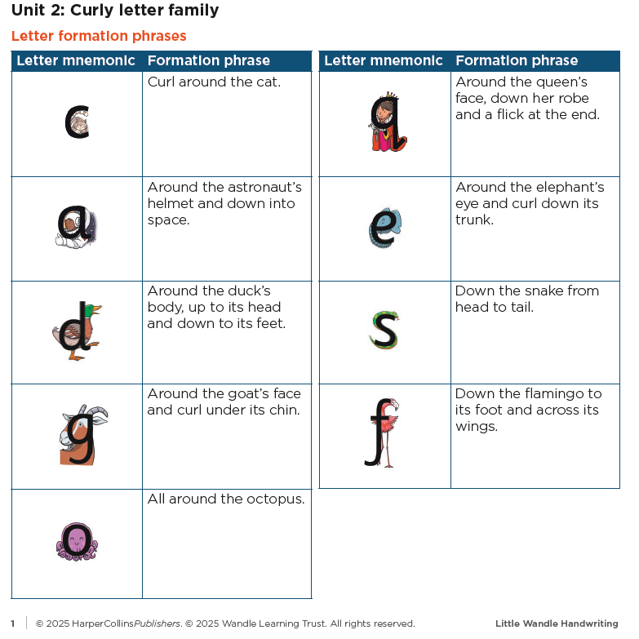
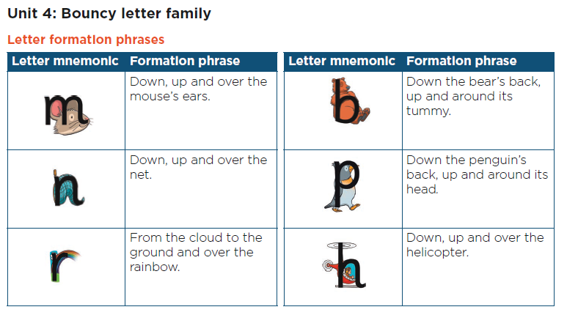
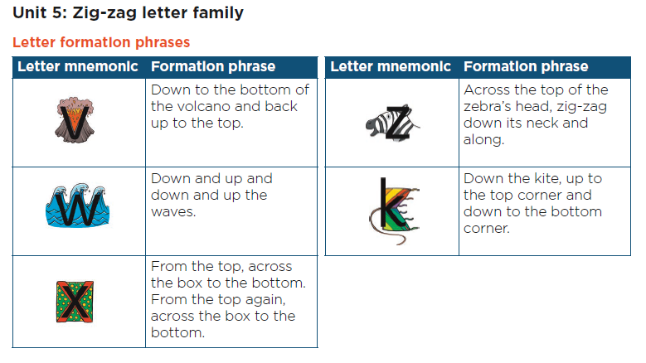
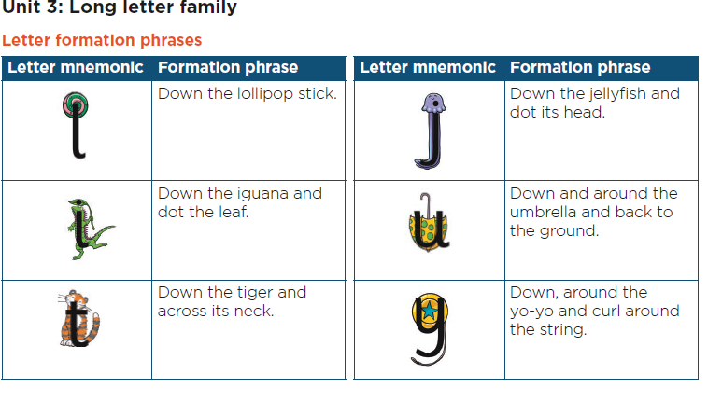
These are the mnemonics used for letter formation.

Slide 9
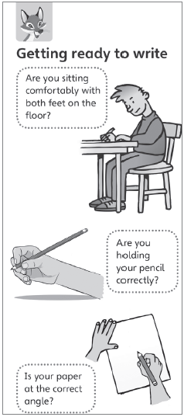
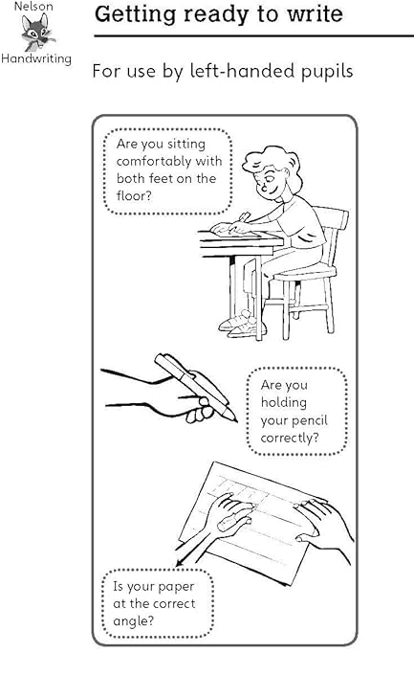
Y1
Pupils should be taught to:
• sit correctly at a table, holding a pencil comfortably and correctly
• begin to form lower-case letters in the correct direction, starting and finishing in the right place
• form capital letters • form digits 0–9 • understand which letters belong to which handwriting ‘families’ (i.e. letters that are formed in similar ways) and to practise these
Y2
Pupils should be taught to:
form lower-case letters of the correct size relative to one another
• start using some of the diagonal and horizontal strokes needed to join letters and understand which letters, when adjacent to one another, are best left unjoined
• write capital letters and digits of the correct size, orientation and relationship to one another and to lower-case letters
• use spacing between words that reflects the size of the letters, so that later joins do not create extra, confusing shapes
Is there any difference in approach for left-handed pupils?

Slide 10
Spelling & Handwriting in KS1
Daily Little Wandle Phonics lessons are where the children continue to learn how to read and spell. They are taught the different graphemes there are for the same phoneme - for example: bodies monkey fever hairy field belief.
Children also continue to practise writing tricky words (their) and write a sentence at the end of the lesson.
How can we help children to spell words where there are multiple ways to spell the same sound?
Where in the word?
fever - near the beginning of the word
monkey hairy - at the end
field belief bodies - in the middle
When do children start spelling tests?
The children write sentences in phonics daily and teachers also use spelling dictations to support fluency of spelling.

Slide 11
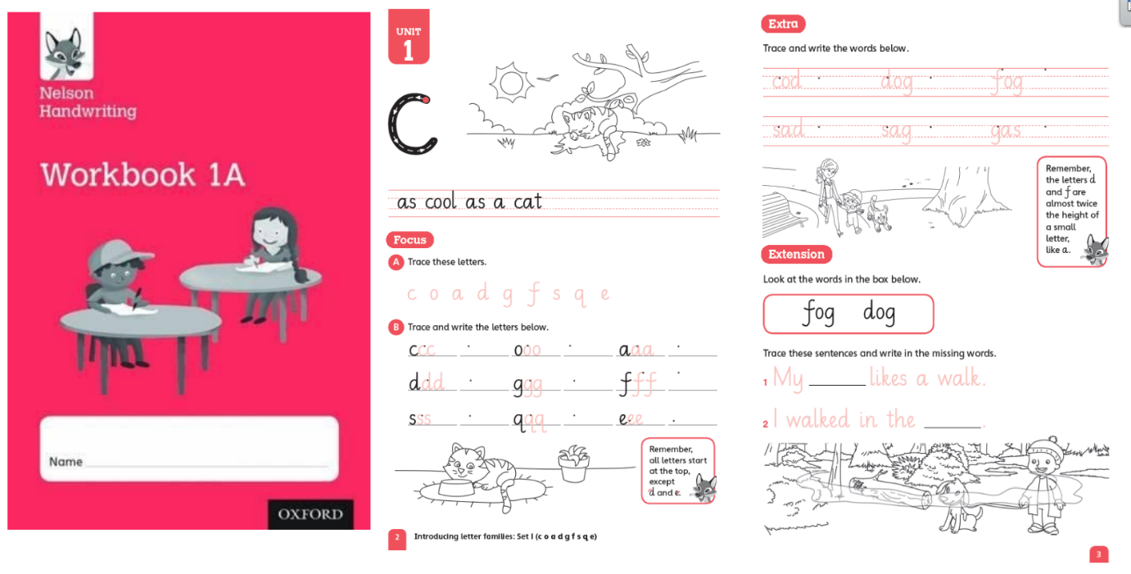
Spelling & Handwriting in KS1
Handwriting is taught as a separate lesson to phonics and supports children to practise their letter formation. They continue to practise sitting at a table ready to write. Workbooks are used to overlearn letter formation and develop automaticity. Children may also draw letters in the air, on each other’s backs (with their fingers) and using a range of materials to support automaticity.
Do children have pen licences?
All children write in pen - there is no licence they need to earn.

Slide 12
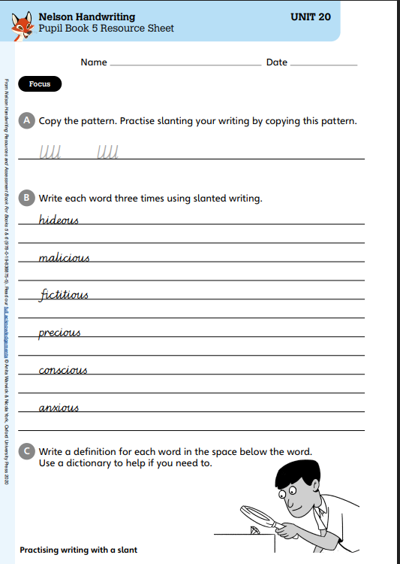
KS2 Writing
KS2
In key stage 2, the national curriculum focuses on increasing the legibility, consistency and quality of pupils’ handwriting, with the aim of increasing the fluency and speed with which they are able to write down what they want to say.
How are children with dyslexia helped with spelling and handwriting?
Children with dyslexia will often struggle with working memory and benefit from repeated practice in order to develop automaticity.
There are also evidence-based interventions that children can use to support their spellings such as Nessy (Y3 intervention - all children receive a Nessy screener in Y3). If a parent has a concern then the class teacher is best placed to discuss this further.

Slide 13

Spelling & Handwriting in KS2
In KS2, spellings are taught using No Nonsense Spelling. Spelling patterns and rules are practised throughout the week, including learning statutory words, common exception words and personal spellings.
We follow the sequence:
Revise – Teach – Practice – Apply
Patterns are taught weekly and homework is linked to taught patterns. Children have weekly spelling sheets to practise at home.
Friday Dictation LKS2
I’d love to submerge myself under the water.
The deep caves are subterranean.
In America you can ride on the subway.
You’d love seeing the stars through a telescope.
Do you have a television in your house?
When do children start spelling tests?
The children have spelling dictation on Fridays. This gives them the chance to practise and apply their spelling patterns in context.

Slide 14
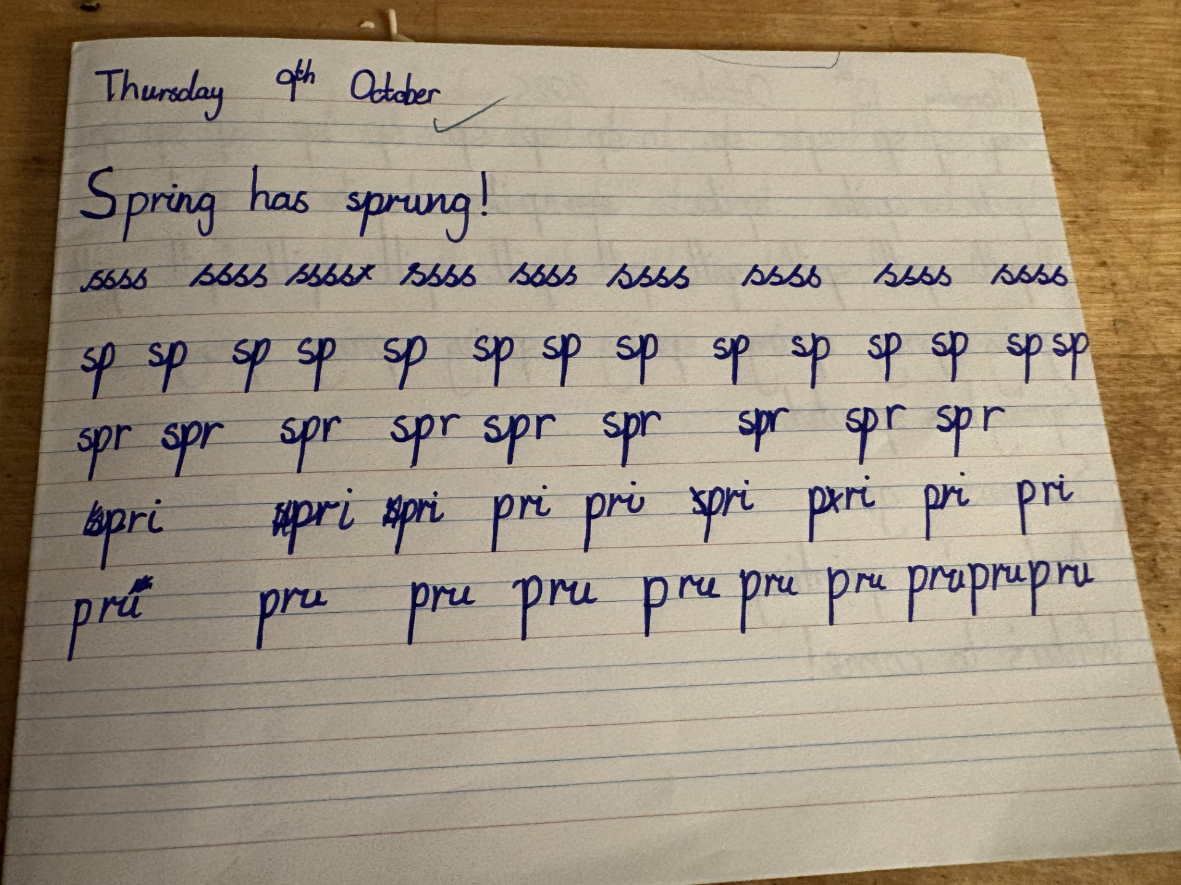
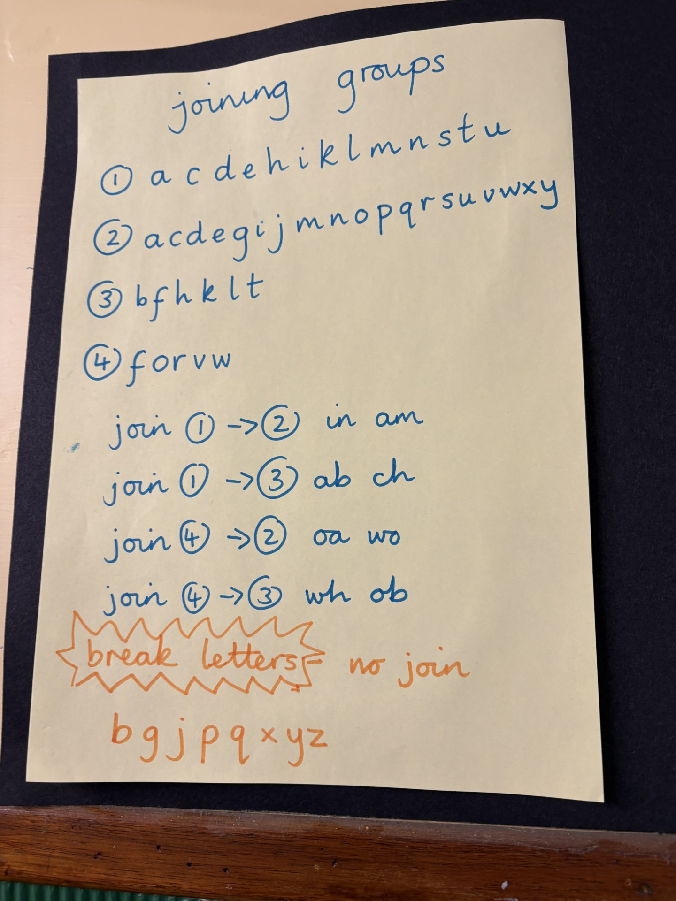
How does handwriting change through the school?

Slide 15
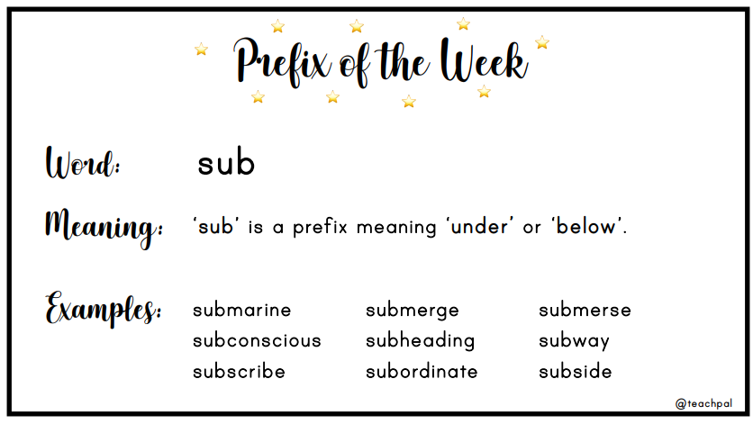
LKS2 Spelling Lesson
Today we will focus on the prefix sub-
which usually means under/below

Slide 16
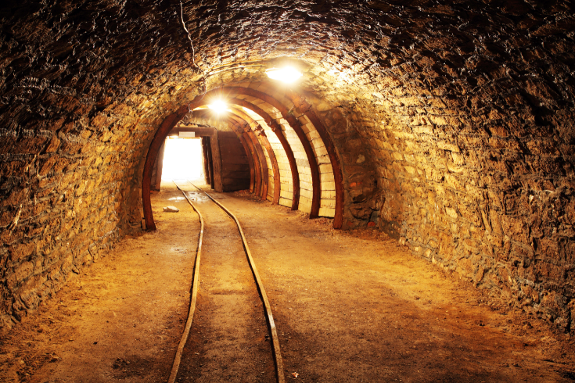
Which word am I?
under the earth’s surface
submarine
submerge
subordinate
subterranean

Slide 17
Which word am I?
under the earth’s surface
submarine
submerge
subordinate
subterranean

Slide 18
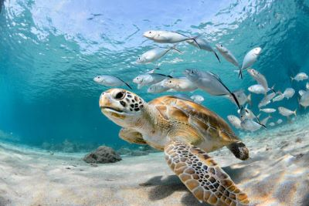
Which word am I?
under the water
submarine
submerge
subordinate
subterranean

Slide 19
Which word am I?
under the water
submarine
submerge
subordinate
subterranean

Slide 20
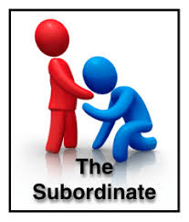
Which word am I?
under the control of somebody else
submarine
submerge
subordinate
subterranean

Slide 21
Which word am I?
under the control of somebody else
submarine
submerge
subordinate
subterranean

Slide 22

Which word am I?
a ship designed to go completely under the sea
submarine
submerge
subordinate
subterranean

Slide 23
Which word am I?
a ship designed to go completely under the sea
submarine
submerge
subordinate
subterranean

Slide 24
Quickwrite: How many times can you correctly spell
subterranean
In 1 minute?

Slide 25
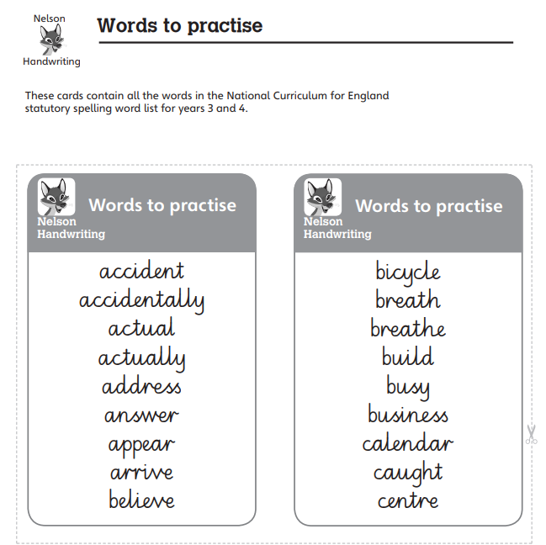

Spelling & Handwriting in KS2
Handwriting is taught using the Nelson Handwriting scheme as a weekly lesson with children practising the taught letters in their handwriting book through the week. Letter formation is the same as Little Wandle but from Y3 children learn to loop their k to support fluent, joined up handwriting. Handwriting is often linked to the taught spelling patterns. In UKS2 handwriting is taught where needed.
Year 3-4 spellings
Gaining automaticity requires explicit teaching, extensive practice and effective feedback.

Slide 26
Spelling & Handwriting in KS2
Children develop their own fluent, legible style and may start to write using a slanted style.
There are purposeful writing opportunities to showcase handwriting such as the end of an English unit.

Slide 27
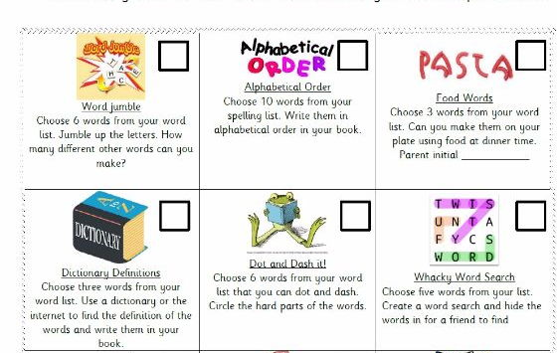
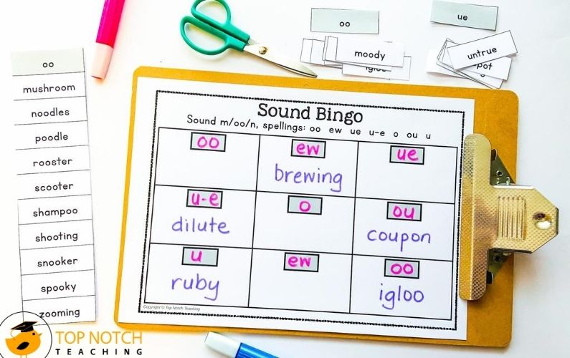
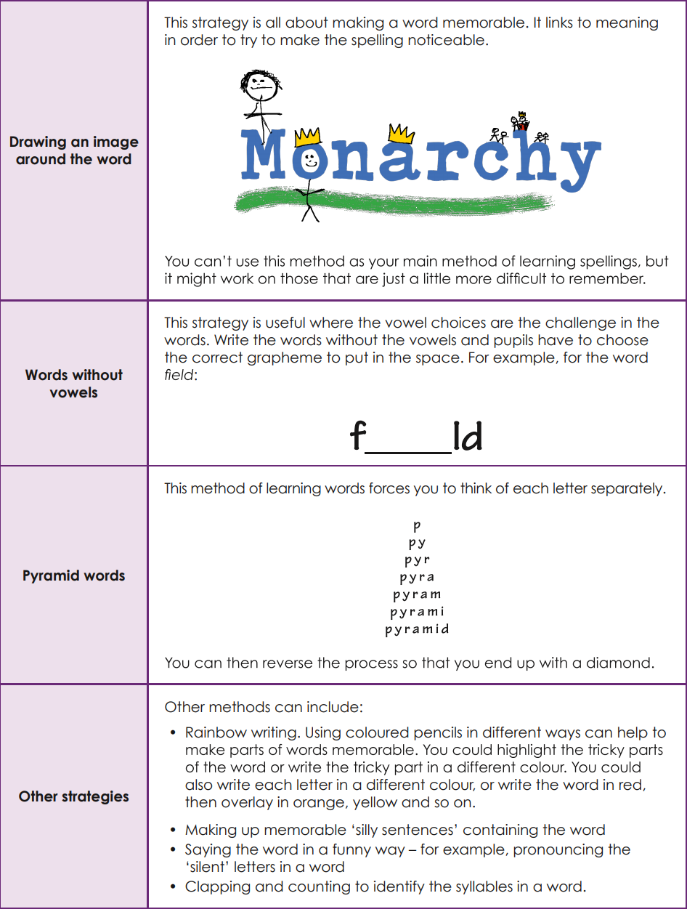
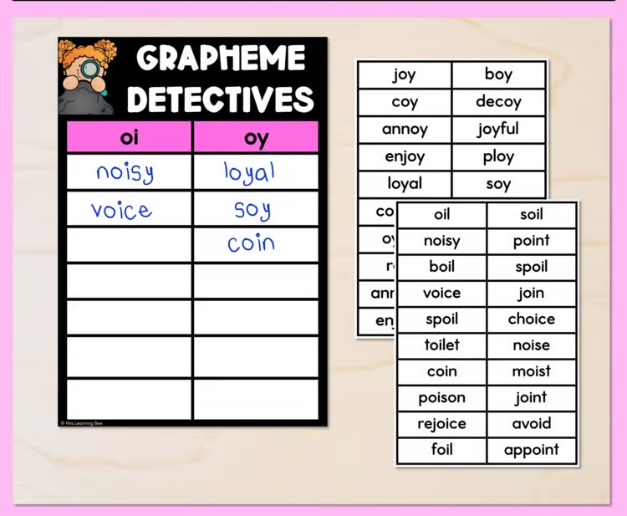
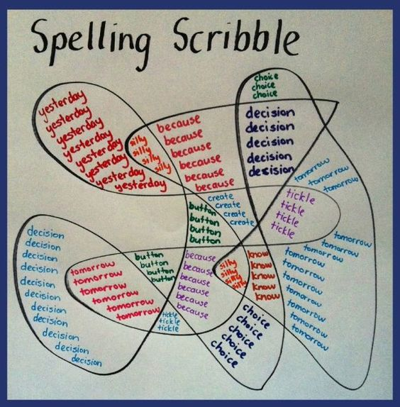
How can I support spelling at home?

Slide 28
Useful Resources/Websites
Oxford Owl website - including lists of words for different year groups, videos and ideas for games.
https://home.oxfordowl.co.uk/english/primary-spelling/
https://spellingframe.co.uk/ (spelling games and printables)
BBC bitesize:
KS1: https://www.bbc.co.uk/bitesize/topics/zcgv39q
KS2: https://www.bbc.co.uk/bitesize/articles/zbm8scw

